Slide 1

National Update on Recruitment/Hiring Trends/Educator Pipeline
Kelly Coash-Johnson
Executive Director
AASPA
American Association of School Personnel Administrators
American Association of School Personnel Administrators

Slide 2
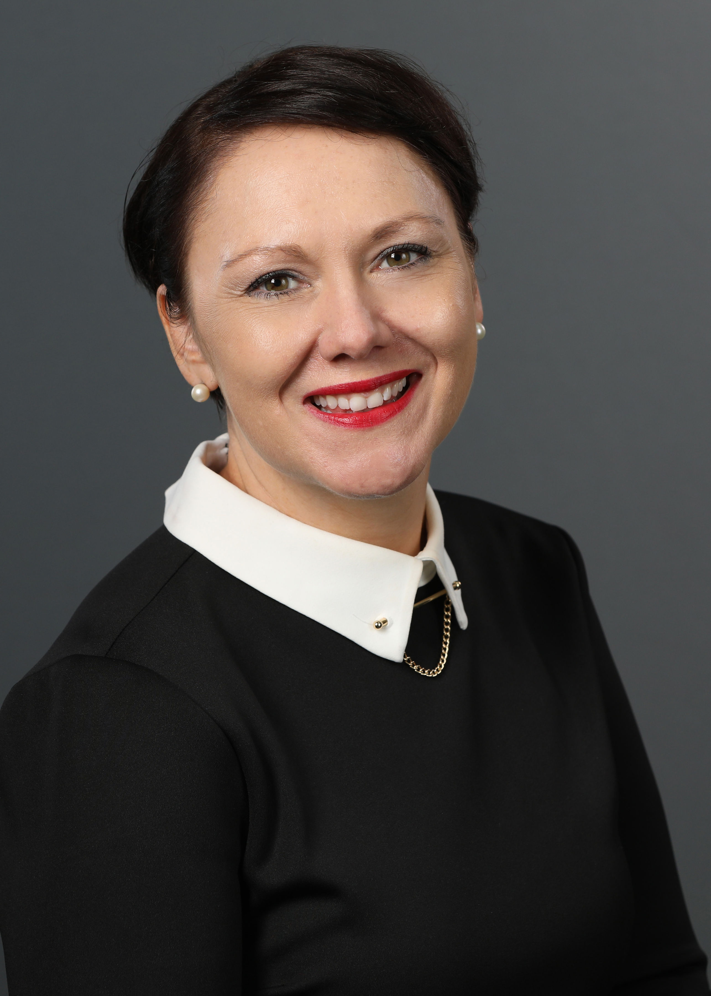


Kelly Coash-Johnson, pHCLE
Executive Director, American Association of School Personnel Administrators
Email: Kelly@aaspa.org
Twitter: @CoashJohnson
Follow us on LinkedIn
Follow us on Twitter
American Association of School Personnel Administrators
American Association of School Personnel Administrators

Slide 3
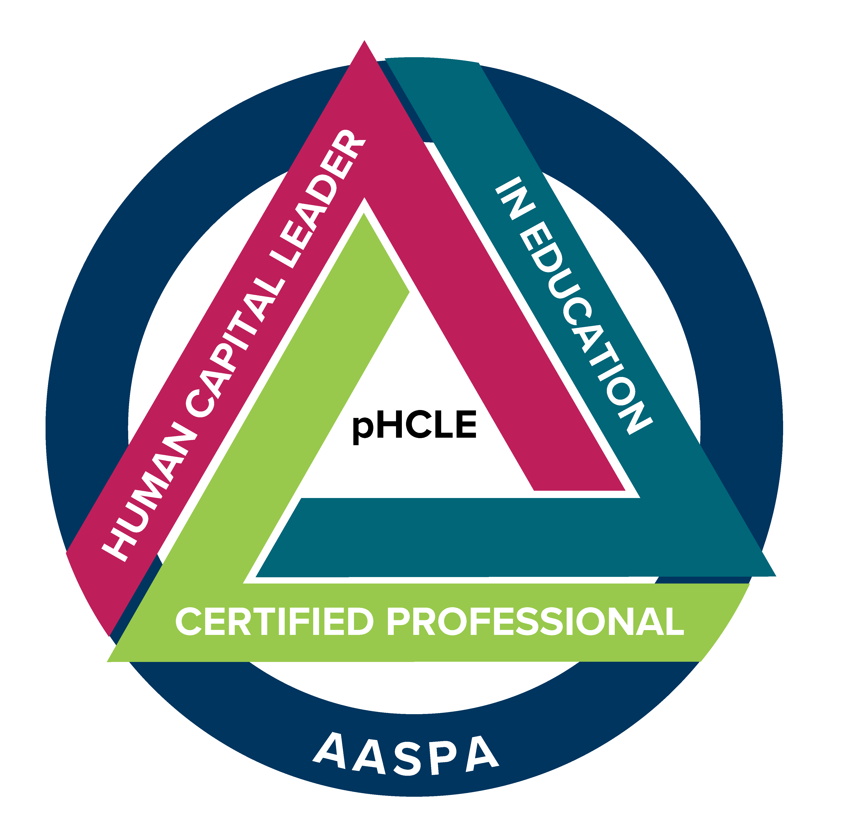
Today’s Presentation
Outline:
Information and links on teacher shortage history/tracking
AASPA’s continued Priorities
3 Major Issues to Watch in 2022
American Association of School Personnel Administrators

Slide 4
Why are we here?
Declining Interest in the profession
According to a survey by the American Association of Colleges for Teacher Education (AACTE), as noted in the report, said the No. 1 reason for the enrollment drop was the perception of teaching as an undesirable career.
We are our own worst enemy.
Post Covid - 27% of teachers said they were considering leaving their jobs, retiring early, or taking a leave of absence due to the pandemic.
  Good News: States and Districts are reporting teacher turnover declines - https://www.nctq.org/blog/Are-teachers-quitting
AACTE – August 2018 Report: https://aacte.org/resources/colleges-of-education-a-national-portrait
American Association of School Personnel Administrators

Slide 5
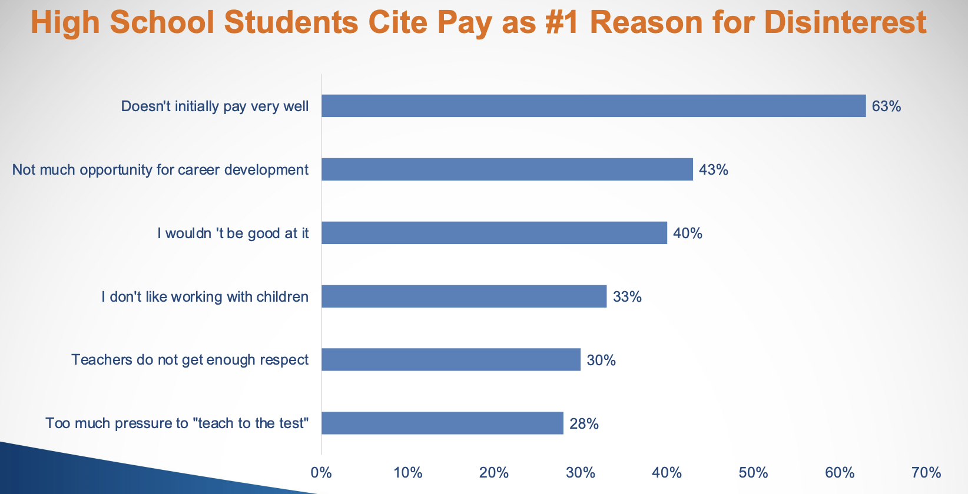
https://www.act.org/content/dam/act/unsecured/documents/pdfs/Encouraging-More-HS-Students-to-Consider-Teaching.pdf
American Association of School Personnel Administrators

Slide 6
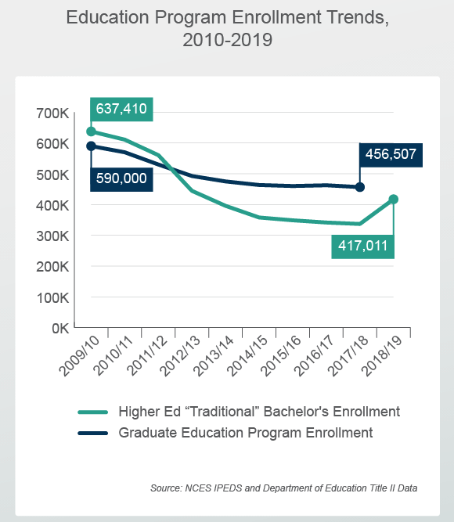
Why are we here?
2. Declining enrollment in teacher training programs
  American Association of Colleges for Teacher Education found the average number of education graduates across all institution types fell by 24% from 2009-10 to 2018-19.
  Post Covid – 60% of colleges reporting a decline due to the pandemic
  As of 2016, some 18 percent of public school teachers entered the profession via alternative route to certification program
https://aacte.org/2020/10/aacte-issue-briefs-examine-education-degrees-trends-and-future-implications-for-teacher-workforce/
https://encoura.org/the-teachers-are-not-alright/
American Association of School Personnel Administrators

Slide 7
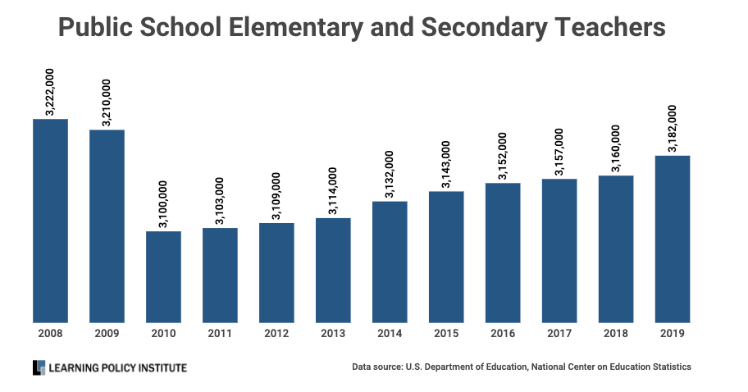
The impact of a Recession on Teaching Positions
Great Recession We lost more than 120,000 teaching positions.
https://learningpolicyinstitute.org/blog/impact-covid-19-recession-teaching-positions
American Association of School Personnel Administrators

Slide 8
Why are we here?
3. Teacher Retention/Turnover
RAND Survey in early 2021 found that 25% of teachers indicated a desire to leave their jobs compared to an average national turnover rate of 16% pre-pandemic
About 30% of new teachers leave the occupation within their first five years
Teacher turnover is highest in the South (16.7%) and lowest in the Northeast (10.3%)
Teachers of color have higher turnover rates (19% vs 15%)
51% of teachers report manageable workloads and 53% cited working conditions as primary reasons
About 23% of the teaching workforce is between 50 and 59 years old, and 7% are older than 60
Source: https://www.brookings.edu/blog/brown-center-chalkboard/2021/09/08/how-the-pandemic-has-changed-teachers-commitment-to-remaining-in-the-classroom/ https://files.eric.ed.gov/fulltext/ED579971.pdf and https://nces.ed.gov/pubsearch/pubsinfo.asp?pubid=2018144
https://www.rand.org/pubs/research_reports/RRA1108-1.html
American Association of School Personnel Administrators

Slide 9
Why are we here?
Let’s Talk What is Cost’s to Replace…
National Data
$2.2 Billion per year on teacher attrition
$4.9 billion per year for replacing teachers who
transfer schools
District Data
$4,366 per teacher in a small rural district
$20,000 per teacher in a very large district
Separation Costs:
Removing from payroll and processing
Paying substitutes to cover
Recruitment and Hiring Costs:
Advertising
Traveling to job fairs
Responding to inquiries, corresponding to applicants
Conducting Interviews, background checks etc
Training Costs:
Coordinating mentoring programs, onboarding workshops and professional development
The Learning Policy Institute as a list of Separation Costs, Recruitment and Hiring Costs and Training Costs associated with Replacement: https://learningpolicyinstitute.org/about-teacher-turnover-calculations
American Association of School Personnel Administrators

Slide 10
Why are we here?
4. Teacher Pay – Will money solve all our problems?
How does your state compare / How does your school compare?
  https://learningpolicyinstitute.org/product/understanding-teacher-shortages-interactive
  The current state of teacher pay in the nation’s large school districts - https://www.nctq.org/blog/Upping-the-ante:-The-current-state-of-teacher-pay-in-the-nations-large-school-districts
The salary for a first-year teacher with a bachelor's degree ranges from approximately $35,000 to just above $59,000, adjusted for cost of living.
Salaries are the quintessential incentive to attract the right teacher to the right position. Therefore, districts need to be strategic about how they pay. https://www.nctq.org/publications/Smart-Money-2.0?gclid=CjwKCAjw7--KBhAMEiwAxfpkWNMWSkQ6wUZ-SYq8-s3dV5zwhEAygfjmcFD--hRL78hQwrtga6RATBoCDkEQAvD_BwE#takeways
What is in Teacher Compensation? - https://www.ed.gov/oii-news/teacher-compensation
American Association of School Personnel Administrators

Slide 11
Learning Policy Institute highest average salary:
DC ($56,313)
New Jersey ($53,177)
California ($49,303)
Data on lowest average salary:
Montana ($32,871)
Missouri ($32,970)
Arkansas ($35,201)
Pennsylvania
($46,991) #11– starting
($71,479) #11 – average
https://www.nea.org/resource-library/teacher-pay-and-student-spending-how-does-your-state-rank
Learning Policy Institute
2021’s Best and Worst
Highest Annual Salaries
(Adjusted for Cost of Living)
1. New York
2. Michigan
3. Pennsylvania
4. Illinois
5. Washington
Lowest Projected Teacher Turnover
1. Kentucky
2. Montana
3. Missouri
4. New York
5. Alabama
Lowest Annual Salaries
(Adjusted for Cost of Living)
47. South Dakota
48. New Hampshire
49. Florida
50. Hawaii
51. Maine
Highest Projected Teacher Turnover
44. Indiana
45. Virginia
46. Arizona
47. Vermont
48. District of Columbia
https://wallethub.com/edu/best-and-worst-states-for-teachers/7159/#main-findings
American Association of School Personnel Administrators

Slide 12
Issues to Watch
State Reciprocity Rules – Where can you recruit and where can you not
  8 States have full reciprocity (Arizona, Florida, Hawaii, Illinois, Mississippi, Missouri, Nevada, Oklahoma)
  Most states will accept from All states on a “provisional” basis
  Several states flat out say no to other states without additional tests which cost money
  Some states are almost blacklisted from any reciprocity agreements
41% of former teachers cited the ability to seamlessly transfer their license between states as a factor in deciding whether to return to the classroom.
https://www.ecs.org/50-state-comparison-teacher-employment-contract-policies/
https://www.ecs.org/50-state-comparison-teacher-license-reciprocity/
https://eric.ed.gov/?id=ED606883
American Association of School Personnel Administrators

Slide 13
Pennsylvania:
NASDTEC: Yes
Full Reciprocity: No
Require additional coursework for out-of-state? Yes
Require additional assessments for out-of-state: Yes
New York
NASDTEC: No
Full Reciprocity: No
Require additional coursework for out-of-state? Yes
Require additional assessments for out-of-state: Yes
New Jersey
NASDTEC: Yes
Full Reciprocity: No
Require additional coursework for out-of-state? No
Require additional assessments for out-of-state: Yes
*Thirty-one states require that some or all out-of-state teacher candidates take additional coursework or training prior to entering a classroom, or within a certain number of years of teaching.
Ohio:
NASDTEC: Yes
Full Reciprocity: No
Require additional coursework for out-of-state? Yes
Require additional assessments for out-of-state: Yes
West Virginia
NASDTEC: Yes
Full Reciprocity: No
Require additional coursework for out-of-state? No
Require additional assessments for out-of-state: Yes
Maryland
NASDTEC: Yes
Full Reciprocity: No
Require additional coursework for out-of-state? Yes
Require additional assessments for out-of-state: Yes
Delaware
NASDTEC: Yes
Full Reciprocity: No
Require additional coursework for out-of-state? No
Require additional assessments for out-of-state: Yes
American Association of School Personnel Administrators

Slide 14
Issues to Watch
What changes are you seeing in Substitute Requirements/Are these a precursor for the future of teacher certification
American Rescue Plan Act of 2021 - $170.3 billion ($122.8 billion for Elementary and Secondary School Emergency Relief Fund) - Distributed to states, based on Title 1
  Accelerate student learning through extended school year, summer enrichment etc.
  Provide students and staff with safe school reopening
  Upgrade school facilities for healthy learning environments
  Invest in wraparound supports
  Stabilize and diversify the educator workforce and rebuild the educator pipeline
  This act includes provisions that help ensure that federal funds are used in addition to – and not in place of – state and local education funding.
  “We’re making sure schools know they can use ARP and other relief funds to increase wages by offering hiring bonuses for teachers and support staff, and provide permanent salary increases or premium pay.” – Miguel Cardona, Secretary of Education https://thehill.com/blogs/congress-blog/education/584636-school-staffing-shortages-cant-wait-the-biden-administration-is?rl=1
https://learningpolicyinstitute.org/blog/covid-analysis-american-rescue-plan-act-2021
American Association of School Personnel Administrators

Slide 15
Teacher Licensing Changes
Recent changes to alter licensure requirements
Revising existing requirements for initial licensure
Creating new licensure
Filling vacancies through licensure exemptions
Expanding access through alternate routes
Limiting barriers to out-or state teachers
Notable Trends
Many states have lowered or (or removed) academic requirements to enter into teacher programs
25 states have initiatives to recruit and support individuals of color to enter the teacher pipeline
Only half 25 states require Elementary teachers to pass content licensure tests
Eliminating requirements for candidates to pass the edTPA
MI/NJ – Removed general requirement that teachers pass Basic Skills Test
IL, IN, ND, VA – Created new content area licensures
VA – License reciprocity for military spouses
VA – Provisional licensure for certification outside of US
NE – Income tax and student loan programs
https://www.ecs.org/state-information-request-addressing-teacher-shortages-through-licensure-flexibility/
https://www.ecs.org/state-education-policy-watch-list/
https://www.nctq.org/publications/State-of-the-States-2021:-Teacher-Preparation-Policy#conclusion
American Association of School Personnel Administrators

Slide 16
AASPA’s National Legislative Priorities
Educator Shortages There are serious challenges with the teacher pipeline right now. Low wages for teaching positions have led college students to choose other career paths, and high burnout rates have caused many educators to leave the profession entirely. As the older generations approach retirement age, districts are seeing a record number of retirements and are left without any pipeline of recent graduates to fill the open roles. Job postings that had 300 applications in the early 2000s are now receiving an average of 0 to 5 applications. Staffing crises have led to some schools closing entirely for short periods. New and worsening challenges born out of the pandemic have pushed the issue to a breaking point.
Legislative Priorities
Student Debt Relief
Special Education and Other Critical Shortage Area Funding
Alternate Certification Programs
Funding for Paraprofessionals in Classrooms
Reciprocity
https://www.aaspa.org/aaspa-legislative-priorities
American Association of School Personnel Administrators

Slide 17
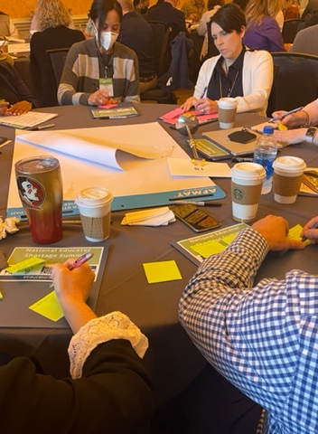
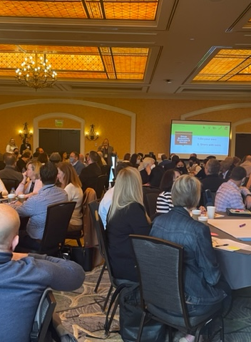
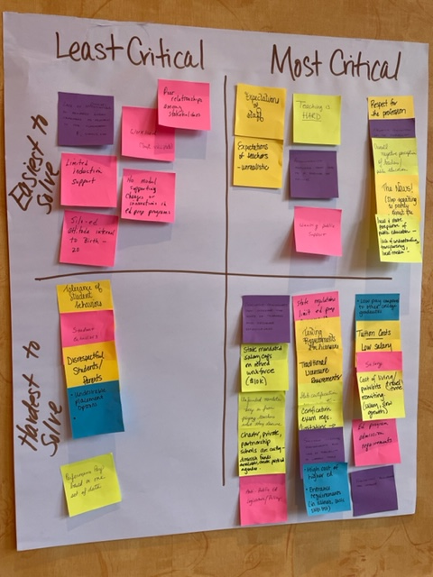
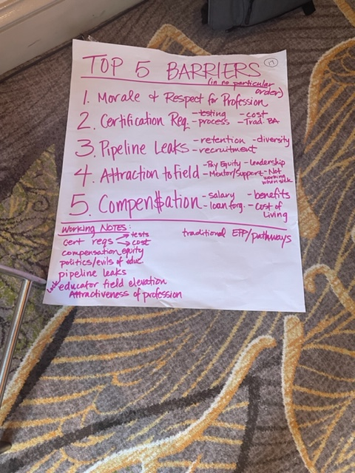
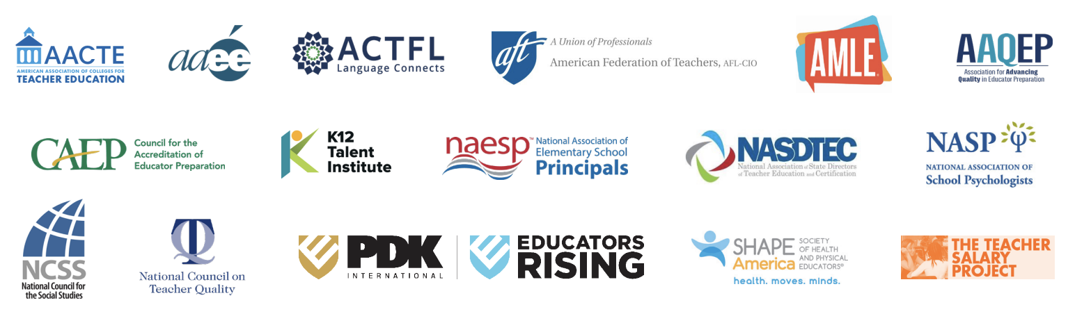
National Educator Shortage Summit – February 2022

Slide 18
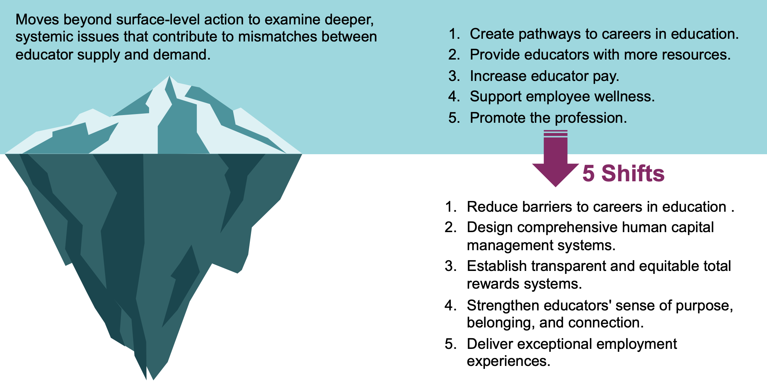
National Educator Shortage Summit
What did we discover…

Slide 19
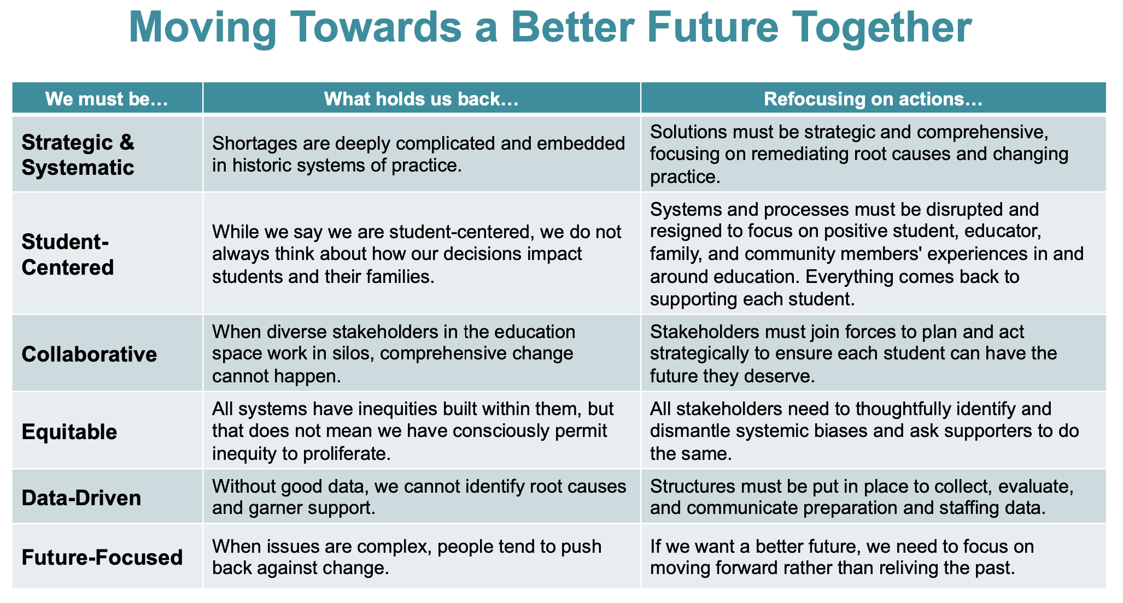

Slide 20
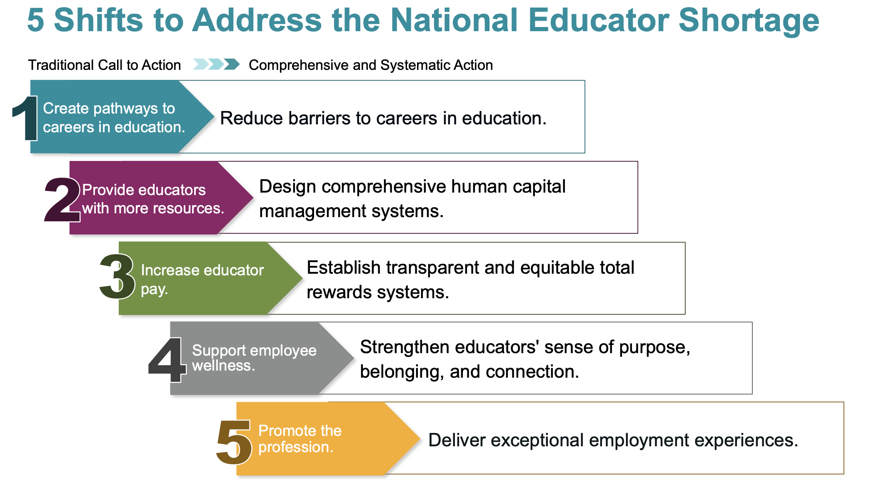

Slide 21

Kelly Coash-Johnson, pHCLE
Executive Director, American Association of School Personnel Administrators
Email: Kelly@aaspa.org
Twitter: @CoashJohnson
Follow us on LinkedIn
Like AASPA on Facebook
Follow us on Twitter
American Association of School Personnel Administrators
American Association of School Personnel Administrators

