Slide 1
Evaluation of Students with Dyslexia & Language-based learning disabilities
Dyslexia Conference Ware Center January 27, 2024
Margaret J. Kay, Ed.D Psychologist

Slide 2
Some Quick Facts about Dyslexia
What it’s not:
A medical problem that educators don’t address
A vision problem
When people see things backwards
What it is:
A language-based learning disability
Problems with phonological processing
Problems with orthographic processing
Impaired ability to form sound-symbol connections

Slide 3
Incidence of Dyslexia in the General Population
20% of all people have some form of dyslexia
Dyslexia is a “spectrum disorder” - you can have mild, moderate or severe problems
This is an “educational problem” which is diagnosed educationally, not medically.

Slide 4
Historical Red Flags
Speech/language skill delays
A history of reading/spelling problems in relatives
Ear infections
Premature birth
Difficulty learning letters and numbers

Slide 5
Case Study: 9-year-old third grader
History of reading/spelling problems father side
Student struggled with writing his name, identifying letters of the alphabet, and rhyming words.
Difficulty processing visual symbols on a page
Pediatric optometrist did not find any significant problems
Struggled to follow two-step directions

Slide 6
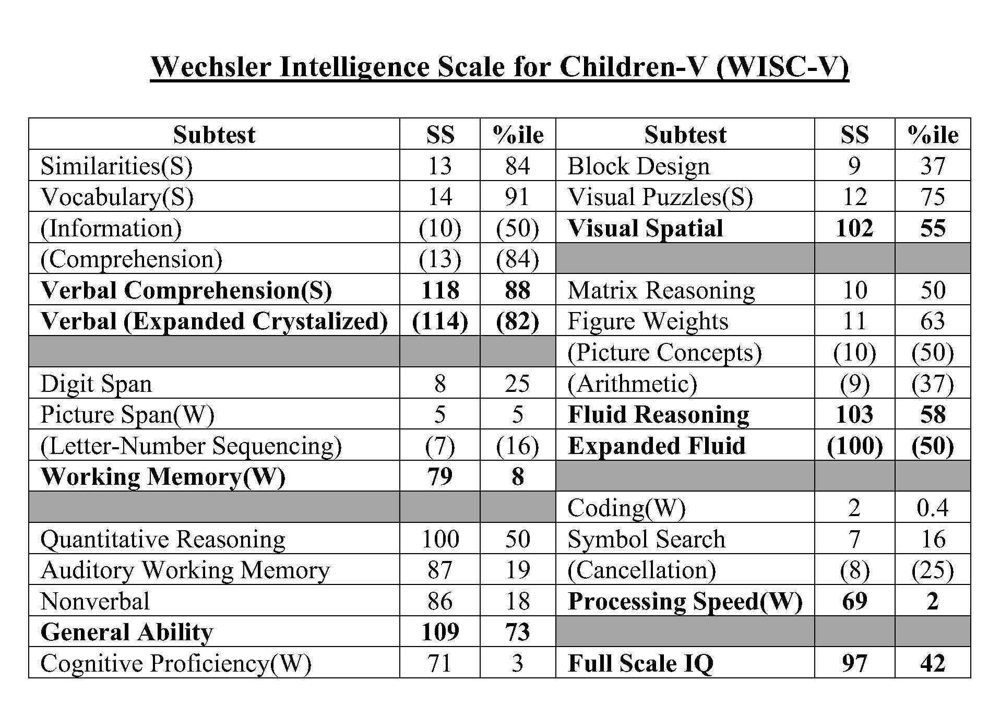
Cognitive Profile

Slide 7
Information Processing Strength
Receptive & Expressive Language

Slide 8
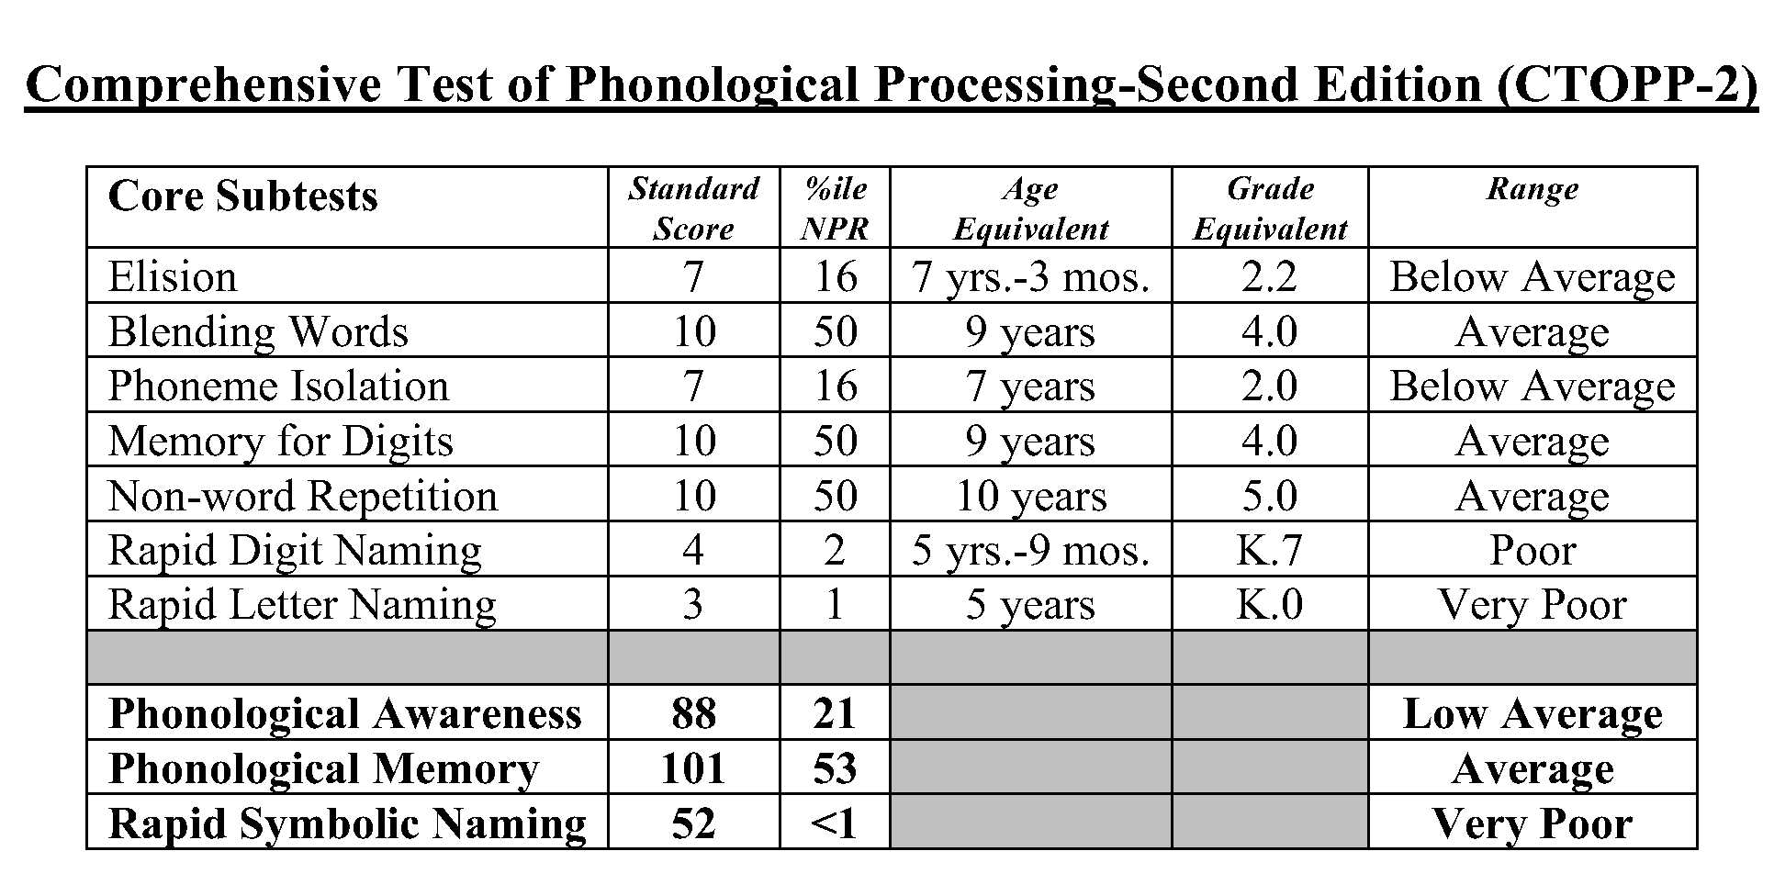
Information Processing Weakness
Phonological Processing and Rapid Naming Speed

Slide 9
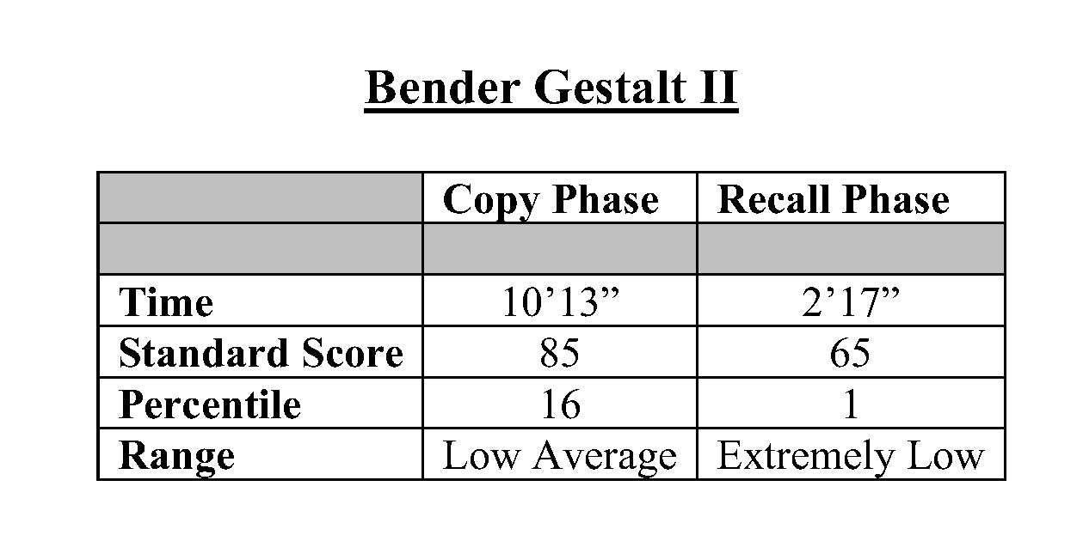
Information Processing Weakness
Visual ability to copy from a model & recall of symbols

Slide 10
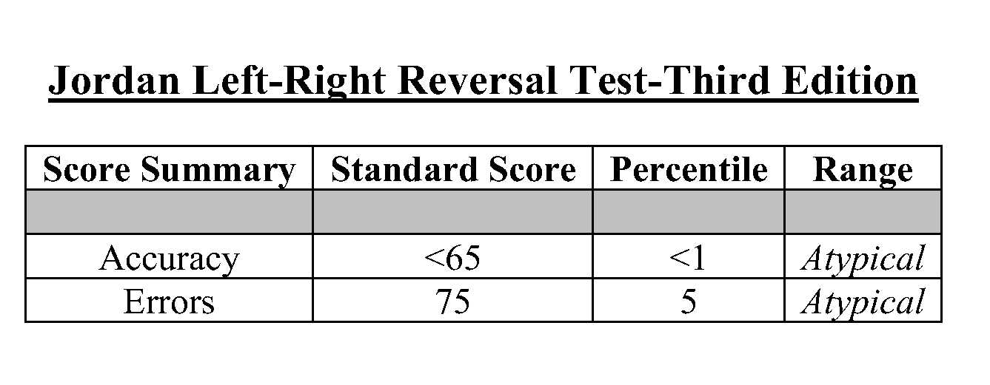
Information Processing Weakness
Perception of Symbol Directionality Orthographic Processing

Slide 11
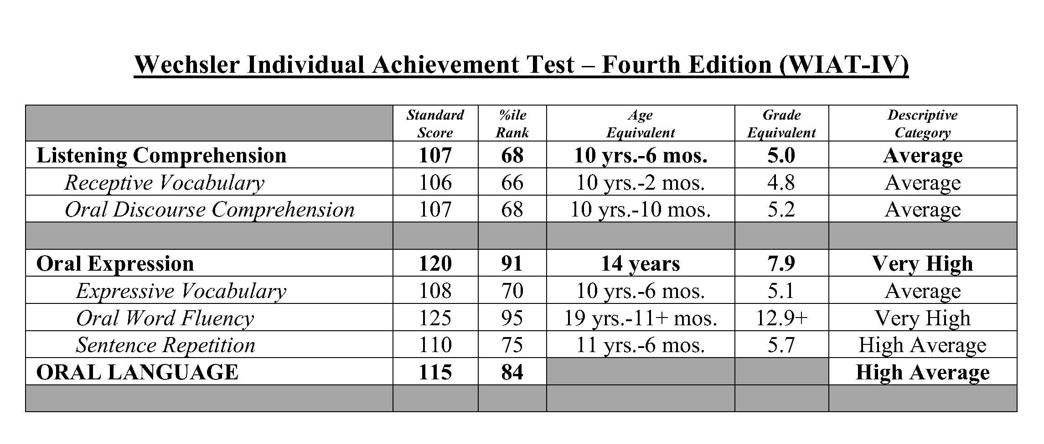
Academic Strengths
Listening Comprehension & Oral Expression

Slide 12
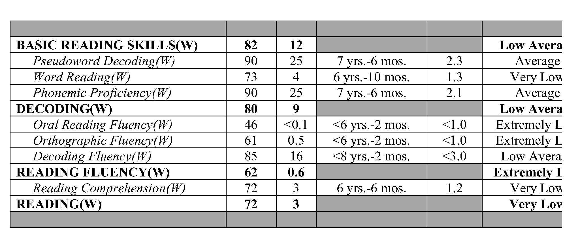
Academic Weakness: Reading
Reading Achievement

Slide 13
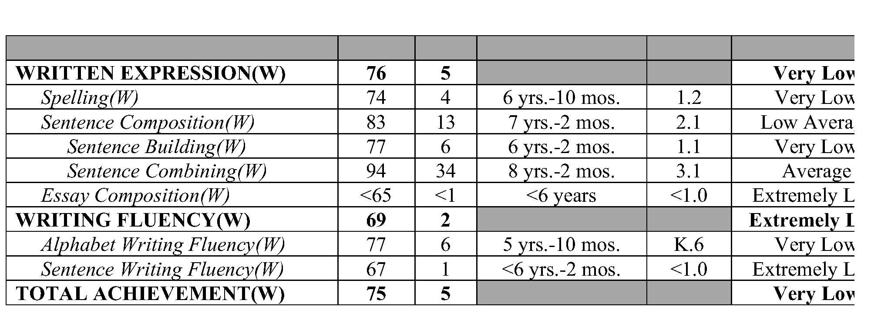
Academic Weaknesses: Written Expression
Written Expression Skills

Slide 14
Academic Weakness: Math
WISC-IV Math

Slide 15
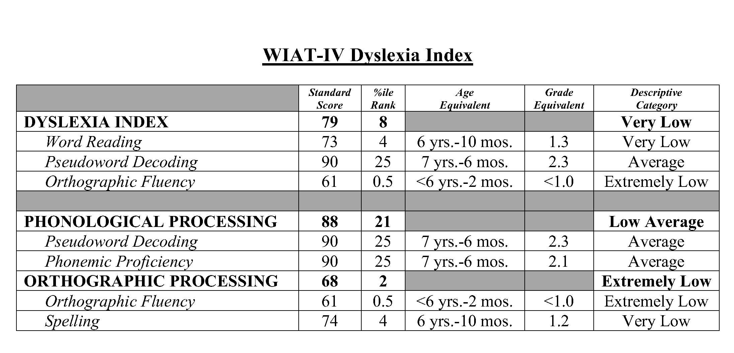
WIAT-IV Dyslexia Index
Dyslexia Index

Slide 16
Data driven Recommendations for Intervention
This is not “Rocket Science”
Synthetic-phonetic code-emphasis instruction: Reading
Wilson Reading System
Orton-Gillingham
RAVE-O: Reading
Orthographic processing problems
Math – theoretical vs. direct sequential
Saxon Math
Writing
Diana Hanbury-King
Assistive technologies

Slide 17
Some Final Thoughts
Critical window of language development
Catching dyslexia early
Problems with the “wait and see” approach
Rule of thumb: Remediate and accommodate
Emotional impacts on kids, parents and teachers
Hurt pride

