Slide 1
How to Survive College-Level Reading
Tips for Success!
Image Credit: Creative Commons
Prepared by Dr. Jennifer W. Shettel
Department of Early, Middle, & Exceptional Education

Slide 2
What’s your GPA right now?
4.0!
Notes:
When in “present” mode, the 4.0 will come in on the next click. Believe it or not, this is always a big shock to students to reframe their mindset that they have a “0” to they have a “Perfect Score” - it’s up to them to keep it there.
Script: When the top question comes in, allow for student response. Then click again for the 4.0 and discuss how reframing how you envision your GPA can make a world of difference.

Slide 3
How can you keep it there and graduate with honors?
Summa Cum Laude: 3.95-4.0
Magna Cum Laude: 3.75-3.94
Cum Laude: 3.50-3.74
Image Credit: Creative Commons
Notes:
Script: “Imagine yourself, four (maybe 5) years from now, having your name called with the highest honors. Keeping your GPA up also qualifies you for more University and Departmental honors and scholarships each year, and it looks impressive on your resume for your future job or graduate school application!”

Slide 4
KEEP UP WITH YOUR READING!
How is it going for you so far this semester?
How much time do you budget to reading?
What have you found that is working for you?
Image Credit: Creative Commons
Notes:
Script: “One of the biggest factors in your success here at Millersville is your ability to keep up with the assigned reading. Unlike when you were in high school, most - if not all - college reading is expected to be done outside of class as part of your preparation for attending class that day. The text serves as a backdrop to the conversation, and most professors won’t lecture directly from the text. Instead, they will expect that you have read it and are prepared to use what you gained while reading to inform your participation in the class discussion that day.” Turn and talk to someone sitting near you about these three questions. Invite individuals to share what they and their partner discussed.

Slide 5
BE AN ACTIVE READER!
Use This! | Not That!
Image Credit: Creative Commons
Notes:
Script: “Being an active reader involves a minds-on approach to reading. What is the point of this slide?” (Invite conversation - why the pencil over the much beloved highlighter?) Idea is to note your thinking beside the words rather than color over the words. Highlighting is a passive reading strategy; annotating is an active one.

Slide 6
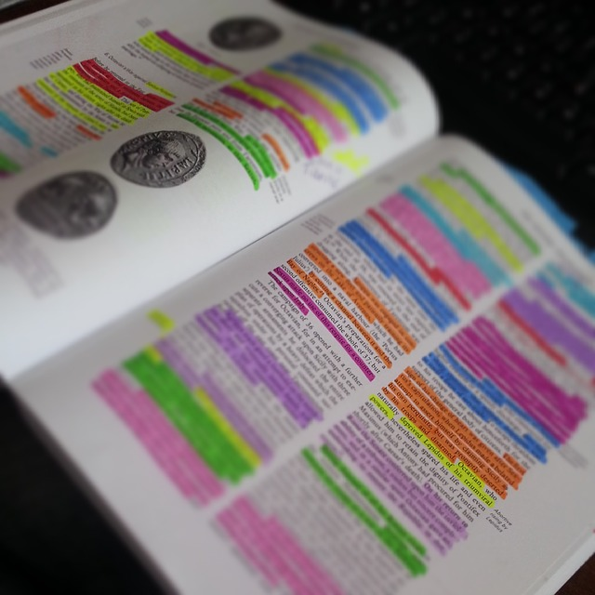
Instead of highlighting...
Image Credit: Creative Commons
Notes:
Script: “Have you ever gotten carried away with your highlighter?”

Slide 7
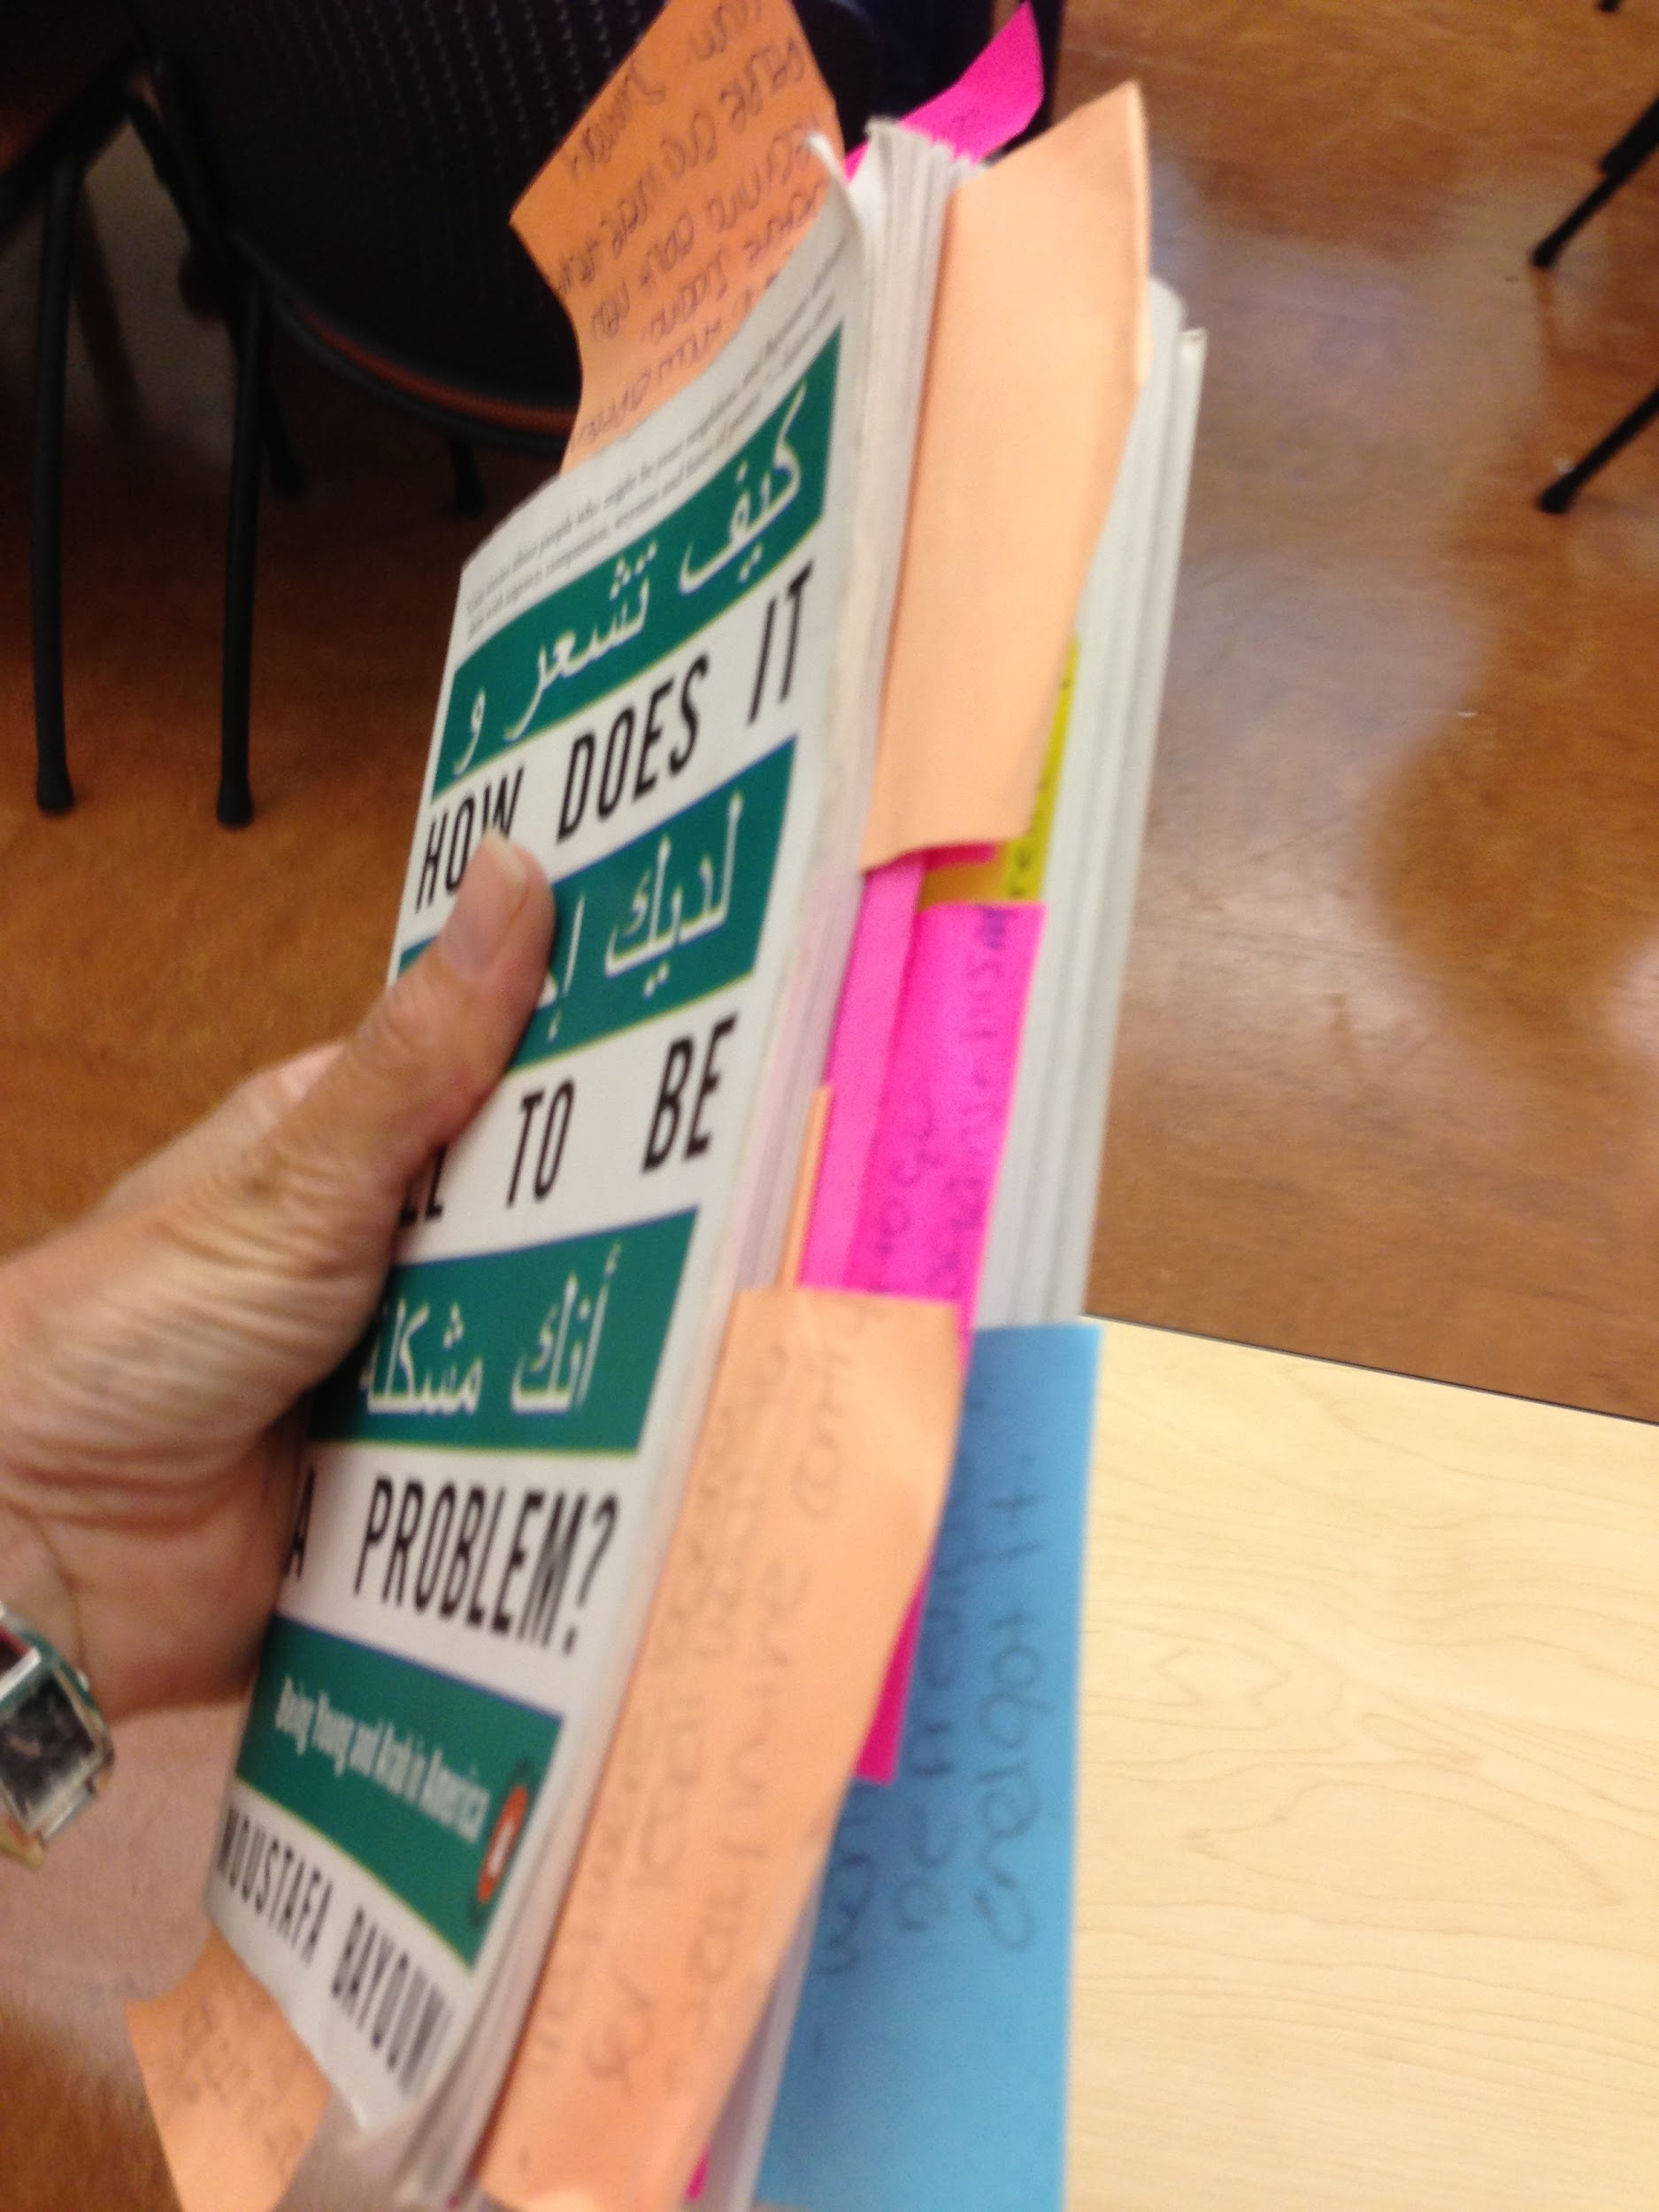
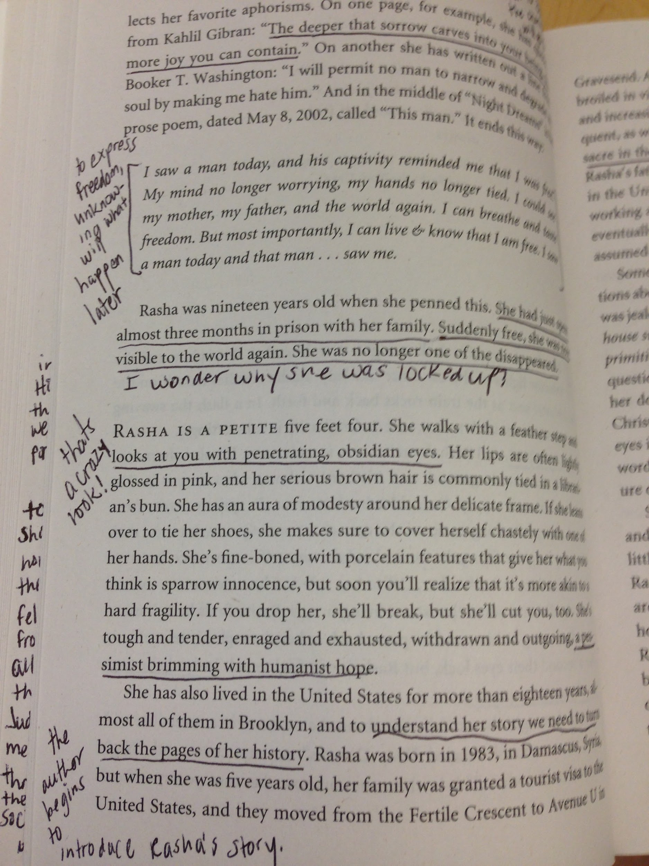
Use Annotating!
or
Image Credit: J. Shettel, 8/7/2013
Text: Bayoumi, M. (2008). How does it feel to be a problem? NY: Penguin Books.
Image Credit: J. Shettel, 8/7/2013
Text: Bayoumi, M. (2008). How does it feel to be a problem? NY: Penguin Books.
Notes:
Script: “Annotating a text means you are actively noting things when you are reading. It means you are going below the surface to do some deep reading. You might be defining new words, underlining important lines, and noting in the margins what struck you as important and why. You also might be using symbols like a question mark if you’re confused about something or you disagree with a statement or a lightbulb if you have an ah-ha moment. Renting your book and can’t write in it? No problem! Buy some post-it notes and stick them directly on the pages. Using an e-reader or an online text? Take some time to get to know the tools that are part of the program - most electronic texts have a way to annotate the text as well.”

Slide 8
In other words….
T
T
T
T
alk
o
he
ext
Notes:
In presenter mode, this slide will show only the 4 T’s. Invite students to guess what each “T” stands for before you click. Each word will “fly in” on the click. Here is a link to a handout on the T4 strategy: http://www.heidipostishek.com/uploads/3/8/0/3/38032275/t4.pdf

Slide 9
How to Annotate
Develop your own system & symbols
Identify and define unknown words
Mark up the margins with your own thoughts, comments, doodles
Ask lots of questions while you’re reading & jot those down!
Read for the “gist”
Harvard College Library (2011). Interrogating Texts: Six Reading Habits to Develop in Your First Year at Harvard. (http://bsc.harvard.edu/files/interrogating_texts_six_reading_habits_to_develop_in_your_first_year_at_harvard.pdf )
Notes:
Script: “Talking to the Text means that you are having an inner dialogue with the author. As you read, become actively aware of what you are thinking and wondering and jot it down. If you prefer to think visually, sketch your thinking instead! This is a great way to synthesize what you are reading.”
Be sure to check out the link included here - this makes a great handout for students. It’s short and to the point. You can even click on this during the presentation and pull it up to look over with your students.

Slide 10
Let’s Try it!
Use whatever text you brought with you today.
Read with a pencil! Annotate, circle, underline. Use symbols, words, phrases
If you can’t write in your book, use post-its or your notebook.
At the end, think about the gist of you just read. Could you explain it to someone else?
Notes:
PRIOR to this class session, be sure to ask students to bring one of their course textbooks or provide them with a short article that is related to your course content. If you need something, you could have them read the Harvard handout (linked on previous slide) or this article about reading deeply and the connection to writing: https://www.psychologytoday.com/blog/prime-your-gray-cells/201606/what-you-read-matters-more-you-might-think . Have students use the active reading strategy of annotating for about 15 minutes. Then debrief on the process - how did it feel, can you see yourself using this? What made it hard/easy? How could this be a better strategy than highlighting your text? How much TIME will you need to budget to get your reading done each week?

Slide 11
Remember...
Use a pencil, not a highlighter
T T T T
Read with a questioning stance
Expand your vocabulary & look up unknown words
Summarize for the gist
KEEP YOUR 4.0!!!

Slide 12
Additional Resources
More information about annotating texts
Collaborative Annotation Activity
Diigo - Online Annotations Made Easy!
Notes:
Here are three links for additional resources you might use with your class.

