Slide 1
UNIV 103 Assessment results Thinking about the future
11 May 2017

Slide 2
Millersville as Students’ First Choice
(n=813)
Student Perception (BSSE)
Notes:
Source: BCSSE 16

Slide 3
Parent’s Educational Background
(n=816)
Student Perception (BSSE)
Notes:
Source: BCSSE 16
Either parent

Slide 4
Student perceptions about themselves as students high school vs. college

Slide 5
During your last year of high school, about how many hours did you spend in a typical 7-day week preparing for class (studying, reading doing homework, etc.)?
Student Perception (BSSE)

Slide 6
During your last year of high school, Studying and Reading
Critical Reading Skills
Student Perception (BSSE)

Slide 7
About how many hours do you expect/did you spend in a typical 7-day week preparing for class (studying, reading, doing homework, etc.)?
Student Perception/Self-Report (BSSE & NSSE)

Slide 8
About how many hours do you expect/did you spend in a typical 7-day week working for pay?
Student Self-Report (BSSE & NSSE)
Notes:
I just put it together because I expect someone will comment that our students work so many hours! I actually think it would be better just to put this at the end of the presentation. If someone asks the question, then we will have the slides available. If not, then it won’t bog us down.

Slide 9
During the current school year, about how often have you attended an art exhibit, play, or other arts performance (dance, music, etc.)?
 | 5 or More Events | 3-4 Events | 1-2 Events | Never
Exploratory | 14 | 24 | 40 | 22
Major | 25 | 16 | 33 | 26
34 % of First-Year Students report spending 0 hours participating in extra- and co-curricular activities.
During the current school year, in how many clubs or extra-curricular activities (e.g. Geology club, Band or Choir, intramural sports) did you participate?
 | 5 or More | 3-4 | 1-2 | None
Exploratory | 7 | 9 | 44 | 40
Major | 8 | 23 | 51 | 19

Slide 10
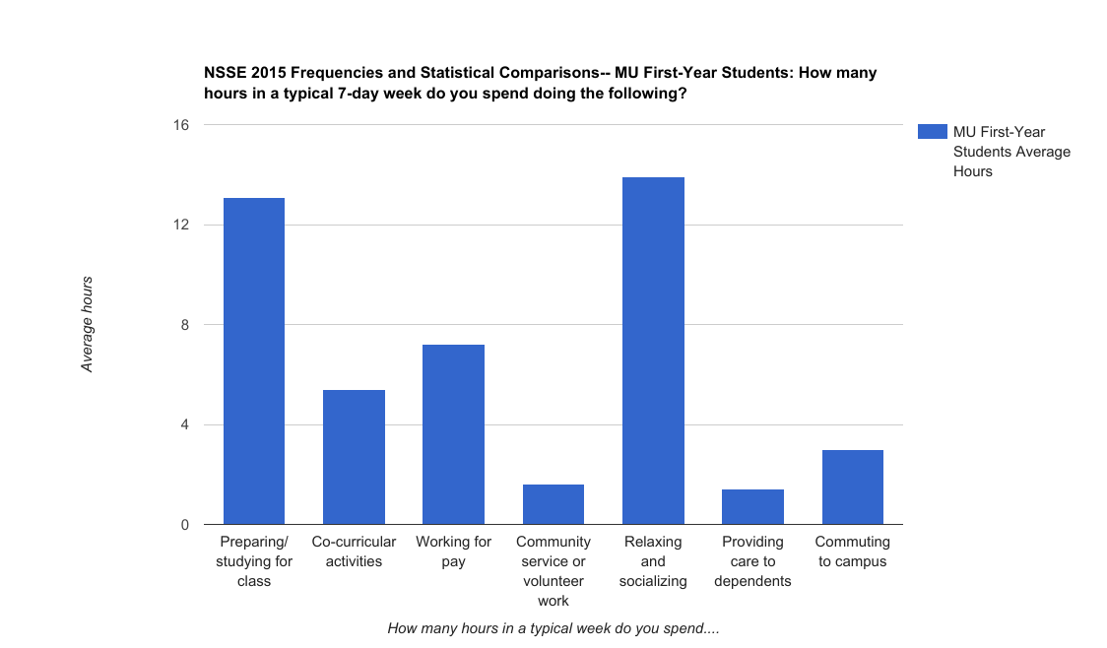
?
ZZZZ

Slide 11
summary
67% of our first-year students report spending less than 15 hours a week studying during their first-year at MU.
Less than 15% of first-year students report working more than 15 hours a week.
34% of our first-year students report spending 0 hours in extra- and co-curricular activities.
What does time management mean?
How do we help our students engage?

Slide 12
How well do you think UNIV103 helped you
 | A great deal / A lot |  | A moderate amount |  | Little / None at all
 | Major | Exploratory | Major | Exploratory | Major | Exploratory
Understand academic expectations at MU | 61 | 45 | 21 | 33 | 18 | 22
Succeed academically at MU | 56 | 43 | 22 | 33 | 22 | 23
Adjust to the social expectations of MU life | 58 | 47 | 15 | 27 | 27 | 27
Identify campus resources that you may have needed | 75 | 67 | 13 | 27 | 12 | 7
Feel like you belong at MU | 60 | 50 | 21 | 22 | 19 | 27
Fall 2016 UNIV103 End-of-Semester Survey

Slide 13
What skills/topics would be most useful?
Students w/ Majors
Exploratory Students
Time Management Strategies
Study Skills
Stress Management Strategies
Understanding College Expectations
Career Services / Co-Ops / Internships
Time Management Strategies
Study Skills
Financial Literacy
Financial Aid more important than Financial Planning
Stress Management Strategies

Slide 14
resources
TIME MANAGEMENT
STRESS MANAGEMENT
FINANCIAL LITERACY

Slide 15
Final thoughts?

Slide 16
Other Category
Students w/ Majors
Exploratory Students
Choosing a Minor
Campus Employment
Picking a different major
Roommate Issues
Motivation & Self-Discipline
Healthy Eating
Campus Employment
Computer Skills
Meal Plans
Writing Skills
What to Expect in Future Years

Slide 17
During your last year of high school, about how many papers, reports, or other writing tasks of the following length did you complete?
Student Perception (BSSE)

Slide 18
About how many hours did you spend in a typical 7-day week working for pay?
Student Self-Report (BSSE & NSSE)
Notes:
I just put it together because I expect someone will comment that our students work so many hours! I actually think it would be better just to put this at the end of the presentation. If someone asks the question, then we will have the slides available. If not, then it won’t bog us down.

Slide 19
Please rate how often these topics were emphasized/discussed in your UNIV 103 course?
 | Major Students | Exploratory Students
 | Percent that answered at least one class
Advising and Registration | 98* | 100*
Note-taking Skills | 75* | 61
Reading Comprehension Skills | 65* | 66*
Study Skills | 82* | 70
Meaning and Use of Syllabi | 84* | 82
Test-taking Skills | 64* | 54
Understanding College Expectations | 92* | 91*
*>25% responded 3 or more classes
Notes:
Lynn

Slide 20
Please rate how often these topics were emphasized/discussed in your UNIV 103 course?
 | Major Students | Exploratory Students
 | Percent that answered at least one class
AOD | 78* | 81*
Campus Safety | 76* | 70
Financial Literacy & Planning | 72* | 65
Mental Health Awareness | 74* | 61
Sexual Health | 58 | 51
Stress Management Strategies | 79* | 66
Time Management Strategies | 87* | 75*
*>25% responded 3 or more classes
Fall 2016 UNIV103 End-of-Semester Survey
Notes:
Lynn

