Slide 1
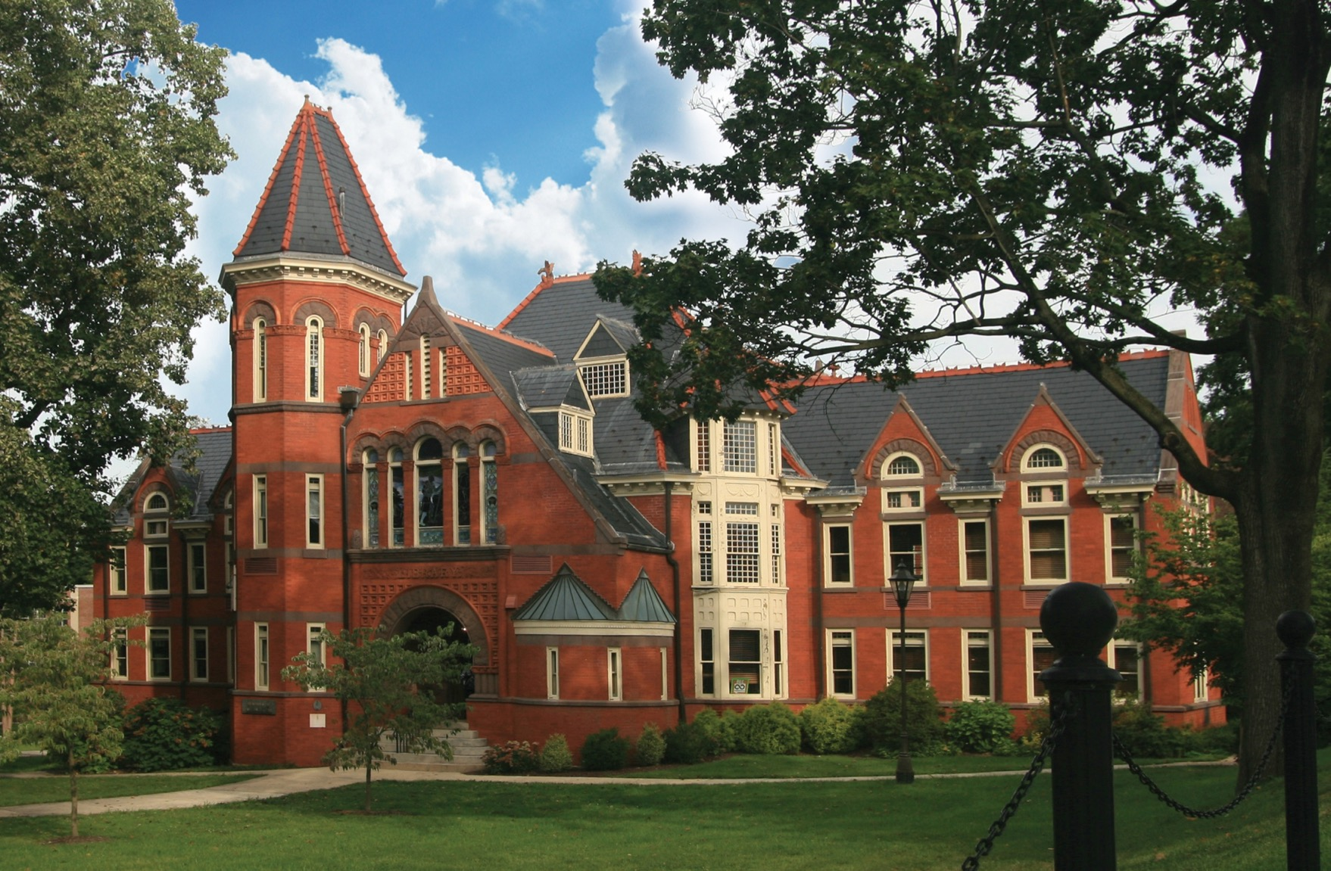

UNIV 103 Faculty Handbook
Contact Information
2022

Slide 2
Table of Contents
Academic Advisement & Student Development
Alcohol & Other Drugs
Center for Civic Responsibility and Leadership
Center for Counseling and Human Development
Center for Health Education and Promotion
Center for Public Scholarship and Social Change
Experiential Learning and Career Management
Financial Aid & Scholarships
Math Assistance Center
Office of International Programs & Services
Office of Learning Services
PSECU, Budgeting & Finance
Starfish
Student Affairs
Success Coaching
University Police & Campus Safety
Veterans Resource Center
University Writing Center
UNIV 103

Slide 3
Academic Advisement & Student Development

Slide 4
Academic Advisement & Student Development
The Office of Academic Advisement seeks to provide an integrated and effective academic advising program, as well as resources and tools for students, faculty, and staff.
The program (a) provides students with opportunities in assessing their interests and academic abilities, (b) encourages the fullest intellectual development of all students, (c) fosters an understanding of the value of a liberal arts education, and (d) provides an environment in which students can learn about the full array of educational opportunities available to them.
Advisors assist students in taking responsibility for learning how to set academic, career, and personal goals, and help students develop strategies for achieving these goals to graduate in a timely manner.
UNIV 103

Slide 5
Academic Advisement & Student Development
McNairy Library, 5th Floor
Dr. David Henriques – Assistant Professor & Chair of Academic Advisement and Student Development, Director of Academic Advising, Coordinator of Exploratory Program
  717-871-7611
  David.Henriques@millersville.edu
  Academic Advisement & Student Development Website: http://www.millersville.edu/advisement/
  MU Exploratory Program Website: http://www.millersville.edu/explore/
UNIV 103

Slide 6

Alcohol & Other Drugs

Slide 7
Alcohol & Other Drugs
Request a presentation and/or resources concerning the effects of alcohol and other drugs. Statistics pertinent to drinking and substance abuse at Millersville University are available through this program, housed within the Center for Counseling and Human Development.
UNIV 103

Slide 8
Alcohol & Other Drugs
Lyle Hall, 3rd Floor
Ms. Abby Peters – Alcohol & Other Drugs Counselor and Instructor
  717-871-7821
  Abby.Peters@millersville.edu
  Website: https://www.millersville.edu/counsel/self-help-library/alcohol-other-drugs.php
UNIV 103

Slide 9
Center for Civic Responsibility & Leadership

Slide 10
Center for Civic Responsibility & Leadership (CCRL)
The Center for Civic Responsibility and Leadership provides student-centered educational and developmental projects and activities. It is premised on the view that through civic education students will be awakened and equipped to become active leaders in civic affairs. The center facilitates voter assistance, poll workers, debates, and legislative speakers.
UNIV 103

Slide 11
Center for Civic Responsibility & Leadership (CCRL)
Huntingdon House, Room 201
Dr. Laura Granruth – Associate Professor and Center Coordinator
  717-871-5956
  Laura.Granruth@millersville.edu
  Website: https://www.millersville.edu/ccerp/walker-center/index.php
UNIV 103

Slide 12
Center for Counseling and Human Development

Slide 13
Center for Counseling and Human Development
Request a presentation and/or resources on the following topics:
  accessing and using Counseling Services at Millersville
  information on psychiatric consult for students
  common reasons for seeking counseling in college
  healthy relationships
  specific disorders, such as anxiety and depression
  other topics as requested
UNIV 103

Slide 14
Center for Counseling and Human Development
Lyle Hall, 3rd Floor
Dr. Joseph Lynch – Psychologist, Chair of Counseling and Human Development
  717-871-7821
  Joseph.Lynch@millersville.edu
  Website: https://www.millersville.edu/counsel/index.php
UNIV 103

Slide 15
Center for Health Education and Promotion

Slide 16
Center for Health Education and Promotion
Cumberland House
Director of CHEP (Position Vacant)
  Website: https://www.millersville.edu/chep/
Peer Education Program – CHEP
  717-871-4141
  Website: https://www.millersville.edu/chep/peereducationprograms/index.php
  Program Request Sheet: https://www.millersville.edu/chep/peereducationprograms/program-request.php
UNIV 103

Slide 17
Center for Public Scholarship and Social Change

Slide 18
Center for Public Scholarship and Social Change (CPSSC)
The Center for Public Scholarship & Social Change brings together teams of faculty, students, and members of the community to engage collaboratively in research for public purposes.
Aiming to leverage the ability for shared research on public issues, the Center for Public Scholarship lends assistance and expertise in identifying research issues, developing research designs, collecting data, writing up results, disseminating results, and working with policymakers and practitioners to resolve issues affecting local, regional, and global communities.
UNIV 103

Slide 19
Center for Public Scholarship and Social Change (CPSSC)
Huntingdon House, Room 203
Dr. Carrie Lee Smith – Associate Professor and Center Coordinator
  717-871-7478
  Carrie.Smith@millersville.edu
  Website: https://www.millersville.edu/ccerp/cps/
UNIV 103

Slide 20
Experiential Learning and Career Management

Slide 21
Experiential Learning and Career Management (ELCM)
Experiential Learning and Career Management houses a wealth of information on volunteering opportunities and career development.
Staff representatives are available to present within the classroom on the services available to students as members of the campus community. Information on these campus resources, as well as assistance with career document reviews, career-readiness programming and job and internship fairs can be discussed.
Presentations can be tailored to fit your needs.
UNIV 103

Slide 22
Experiential Learning and Career Management (ELCM)
Bedford House
Website: http://www.millersville.edu/elcm/
Careers@millersville.edu
Ms. Margo Sassaman – Associate Director, Career Management
  717-871-7656
  Margo.Sassaman@millersville.edu
Ms. Audrey Bare – Assistant Director, Mentorship
  717-871-7654
  Audey.Bare@millersville.edu
  Mentorship@millersville.edu
Ms. Patty Taggart – Employer Relations, Database Records Specialist
(Assistant Director for Internships and Service Learning, Position Vacant)
  717-871-7658
  Patricia.Taggart@millersville.edu
UNIV 103

Slide 23
ELCM Presentations
True Colors (contact Margo Sassaman)
True Colors is a personality assessment that can be administered to students during a specified class period. The results of the assessment help students understand how to work more effectively with groups and how to better respond to the world around them.
Value Card Sort (contact Margo Sassaman)
Value Card Sort is a career assessment which depicts 15 work-related values. Students select what they consider the top three most important values. A discussion ensues about why these values are important within the realm of academics and work and how they can change.
UNIV 103

Slide 24
ELCM Presentations
Internships (contact Patty Taggart)
It is never too early for students to begin thinking about internships to support their educational and career aspirations. A staff member can speak with your first-year students about internship eligibility, requirements, and how to search and apply for internships relevant to their chosen field.
Mentorships (contact Audrey Bare)
Students will learn how to engage in the full student life cycle of Millersville mentorship opportunities, including how to become a mentee in the First Year Student Mentoring Program, serve as a sophomore peer mentor, sign up for the Alumni Career Mentoring Program as a junior mentee, and give professional advice by becoming an alumni career mentor after graduation.
They will also find out about upcoming mentorship training opportunities and events.
UNIV 103

Slide 25
Financial Aid & Scholarship

Slide 26
Financial Aid & Scholarship
Request a presentation concerning financial aid practices for students. Information such as how to apply for financial aid, FAFSA, grants, scholarships, and loans can be obtained through the financial aid counselors.
Call Center hours are 8:00AM to 6:00PM.
All incoming freshman and transfer student scholarships are processed through the Admissions Office.
UNIV 103

Slide 27
Financial Aid & Scholarship
Lyle Hall, 2nd Floor
Ms. Emiyaril Alvarez – Director of Financial Aid
  771-871-5100
  Emiyaril.Alvarez@millersville.edu
Ana Lehneis – Secretary to Director of Financial Aid
  717-871-5802
  Ana.Lehneis@millersville.edu
Financial Aid Office
  717-871-5100
  FA.Mail@millersville.edu
  Website: http://www.millersville.edu/finaid/
UNIV 103

Slide 28
Math Assistance Center

Slide 29
Math Assistance Center
Wickersham Hall, Room 100
Dr. Kevin Robinson – Associate Professor and Assistant Chairperson
  717-871-7313
  Kevin.Robinson@millersville.edu
  Website: http://www.millersville.edu/math/tutoring.php
  Please see the website for Fall 2022 hours.
UNIV 103

Slide 30
Office of International Programs & Services

Slide 31
Office of International Programs & Services
Request a presentation on global educational opportunities for Millersville University students, including (a) study abroad and (b) a variety of professional development programs for academic credit, including internships, student teaching, and discipline-related capstone field experiences. With advance notice, the presentation can be tailored to particular disciplines or interests.
Brochures and other resource materials are available.
UNIV 103

Slide 32
Office of International Programs & Services
Lyle Hall, 1st Floor
Dr. Christina Kinney – Interim Director of International Programs & Services
  717-871-7475
  Christina.Kinney@millersville.edu
  Website: http://www.millersville.edu/globaled/
UNIV 103

Slide 33
Office of Learning Services

Slide 34
Office of Learning Services
Refer students for services and/or request a presentation. The Office of Learning Services strives to support faculty and students by supplementing student learners with (a) academic accommodations, (b) individualized learning assistance, (c) peer tutoring, (d) tutor training, (e) auxiliary aids, (f) assistive technology, (g) academic skills workshops, and (h) individualized programming to promote independent and successful learners for the future.
Tutoring Center
Refer students to receive tutoring services or to be trained as tutors. Drop-in and individual tutoring is available to all Millersville University students free of charge. The current departments served are listed on their website. Tutors are paid and offered additional training through the International Tutor Certification Training program.
UNIV 103

Slide 35
Office of Learning Services
Lyle Hall, 3rd Floor
Ms. Julianne Browne – Administrative Assistant for Learning Services
  717-871-5554
  Learning.Services@millersville.edu
  Website: http://www.millersville.edu/learningservices/
Tutoring Center
  717-871-7222
  Tutoring.Center@millersville.edu
  Website: https://www.millersville.edu/tutoringcenter/
UNIV 103

Slide 36
PSECU, Budgeting & Finance

Slide 37
PSECU, Budgeting & Finance
A representative from PSECU is available to provide presentations on personal finance for college students. Topics addressed in the presentation include (a) using money wisely, (b) budgeting, (c) using checking and savings accounts, (d) establishing good credit, (e) paying bills properly, and (f) proper treatment of student loans. This is not an advertisement on the various accounts available to students through PSECU.
UNIV 103

Slide 38
PSECU, Budgeting & Finance
SMC, Room 113
Kristyne Schonhaut – Community Relations Manager
  717-871-7732
  KSchonhaut@psecu.com
  Website: https://www.PSECU.com/Learn
UNIV 103

Slide 39
Starfish

Slide 40
Starfish
Starfish is Millersville University’s student success platform. It promotes communication between students, course instructors, faculty advisors, and staff in support of student academic achievement.
Tools include: (1) progress surveys which provide timely updates on individual student course progress each semester, (2) early alerts which let students and academic advisors know when a student is staying on track or may need additional academic supports, (3) calendar features to set office hours and student appointments, and (4) student-generated “request help questions” to get learners proactively connected to needed resources and information.
UNIV 103

Slide 41
Starfish
McNairy Library, Room 203
Mr. William Benton – Student Success Specialist and Starfish Coordinator
  717-871-4452
  William.Benton@millersville.edu
  Website: https://www.millersville.edu/dssap/starfish/
UNIV 103

Slide 42
Student Affairs

Slide 43
Student Affairs
SMC, Room 107
Mr. Tom Richardson – Associate Vice President for Student Affairs
  717-871-7083
  Tom.Richardson@millersville.edu
  Website: http://www.millersville.edu/studentaffairs/
UNIV 103

Slide 44
Student Affairs - Offices
Campus Life
Student Memorial Center
J. Whitlow – Director of Campus Life
  717-871-4300
  J.Whitlow@millersville.edu
  Website: https://www.millersville.edu/campuslife/index.php
Ms. Jackie Aliotta – Assistant Director, Student Organizations and Leadership
  717-871-7073
  Jackie.Aliotta@millersville.edu
Ms. Alison Sehl – Assistant Director, Commuter & Off-Campus Support
  717-871-7087
  Alison.Sehl@millersville.edu
UNIV 103

Slide 45
Student Affairs - Offices
Health Services
Witmer Building
Ana Hess, BSN, RN – Nurse Supervisor
  717-871-5250
  Website: https://www.millersville.edu/healthservices/index.php
Interfaith Council of Ministers, The HUB, and Campus Cupboard
Mr. John Birkenbine – Campus Ministry Liaison
  John.Birkenbine@millersville.edu
  Website: http://www.millersville.edu/campusministries/
UNIV 103

Slide 46
Student Affairs - Offices
Student Access and Support Services
Chester House
Ms. Darlene Newman – Director of SASS
  717-871-5369
  Darlene.Newman@millersville.edu
Student Conduct and Community Standards
Witmer Infirmary, 2nd Floor
Lori B. Austin – Director of SCCS
  717-871-5841
  Lori.Austin@millersville.edu
UNIV 103

Slide 47
Student Affairs - Offices
Campus Recreation & Ropes Course
SMC 38
Ms. Allison Yarrow – Director of Campus Recreation
  717-871-4368
  Allison.Yarrow@millersville.edu
  Website: http://www.millersville.edu/campusrec/
University Housing & Conference Services
Lombardo Welcome Center
Mr. Steven Knepp – Associate Director of University Housing & Conference Services
  717-871-4200
  Email: housing@millersville.edu
  Website: http://www.millersville.edu/housing/
UNIV 103

Slide 48
Student Affairs - Offices
New Student Programs
Lombardo Welcome Center
Mr. Chris Jachimowicz – Director of New Student Programs
  717-871-4370
  Chris.Jachimowicz@millersville.edu
UNIV 103

Slide 49
Success Coaching

Slide 50
Success Coaching
Success coaching can be defined as a personalized, one-on-one partnership of helping students improve their life skills and academic performance.
Working with a success coach can help students overcome the different barriers to their success, and this service is available to all students.
UNIV 103

Slide 51
Success Coaching
McNairy Library, 5th Floor
Website: https://www.millersville.edu/success-coaching/
Ms. Rita Miller, M. Ed. – Success Coach
  717-871-5333
  Rita.Miller@millersville.edu
Ms. Olivia Werner, M. Ed. – Success Coach
  717-871-5333
  Olivia.Werner@millersville.edu
UNIV 103

Slide 52
University Police & Campus Security

Slide 53
University Police & Campus Security
Request a presentation on (a) how to react to an emergency, (b) campus safety, (c) car and property security, (d) law enforcement of drugs and alcohol, and (e) other topics related to law enforcement.
Length and content of presentations can be tailored to fit your specific needs.
Lebanon House
Deputy Chief Howard Bauman
  717-871-4357
  Howard.Bauman@millersville.edu
  Website: http://www.millersville.edu/police/
UNIV 103

Slide 54
University Police & Campus Security
Campus Safety Escort
Safety Escort Services are available to students between 11:00pm and 7:00am every evening. A police escort is provided for students travelling from one campus location to another campus location. The police officer may either drive or walk the student to the campus destination. Safety Escort Services can be acquired by calling the non-emergency police line at 717- 871- 4357.
R.A.D. (Rape Aggression Defense System)
R.A.D. is a women-only course that begins with awareness, prevention, risk reduction and risk avoidance, while progressing on to the basics of hand-on defense training. R.A.D. is not a Martial Arts program. The program is nine to twelve hours in length and is free to females within the campus community.
UNIV 103

Slide 55
Veterans Resource Center

Slide 56
Veterans Resource Center
The Veterans Certifying Official in the Office of Financial Aid at Millersville University handles all paperwork for individuals applying for the Department of Veterans Affairs (DVA) educational benefits.
This office is also the link to the DVA in cases of problems with educational benefit processing and connect you with various military scholarship opportunities and the Student Veterans Association on campus.
UNIV 103

Slide 57
Veterans Resource Center
Mercer House
Ms. Yvonne DeBlois – Veterans Resource Center Administrator, until 10/01/22
  717-871-7083
  Yvonne.DeBlois@millersville.edu
  Website: https://www.millersville.edu/veterans/
Ms. Alison Sehl – Veterans Resource Center Administrator, after 10/01/22
  717-871-7087
  Alison.Sehl@millersville.edu
Brandyn Whitmyer – Veterans & State Grant Coordinator, Financial Aid Counselor
  717-871-5100
  Brandyn.Whitmyer@millersville.edu
UNIV 103

Slide 58
University Writing Center

Slide 59
University Writing Center
Refer students for services and/or request a short presentation so students know the purpose of the University Writing Center and how they can use the services to the full extent.
On-line tutoring is also available. Hours of operation are updated at the beginning of each semester and listed on the center’s website.
The center opens the third week of each semester. If assistance is needed before the center opens, please contact Dr. Farkas directly.
UNIV 103

Slide 60
University Writing Center
McNairy Library, Room 106
Dr. Kerrie Farkas – Professor and Coordinator of The Writing Center
  717-871-7399
  Kerrie.Farkas@millersville.edu
Writing Center
  717-871-7389
  Writing.Center@millersville.edu
  Website: https://www.millersville.edu/enwl/writing-center/index.php
UNIV 103

