Slide 1
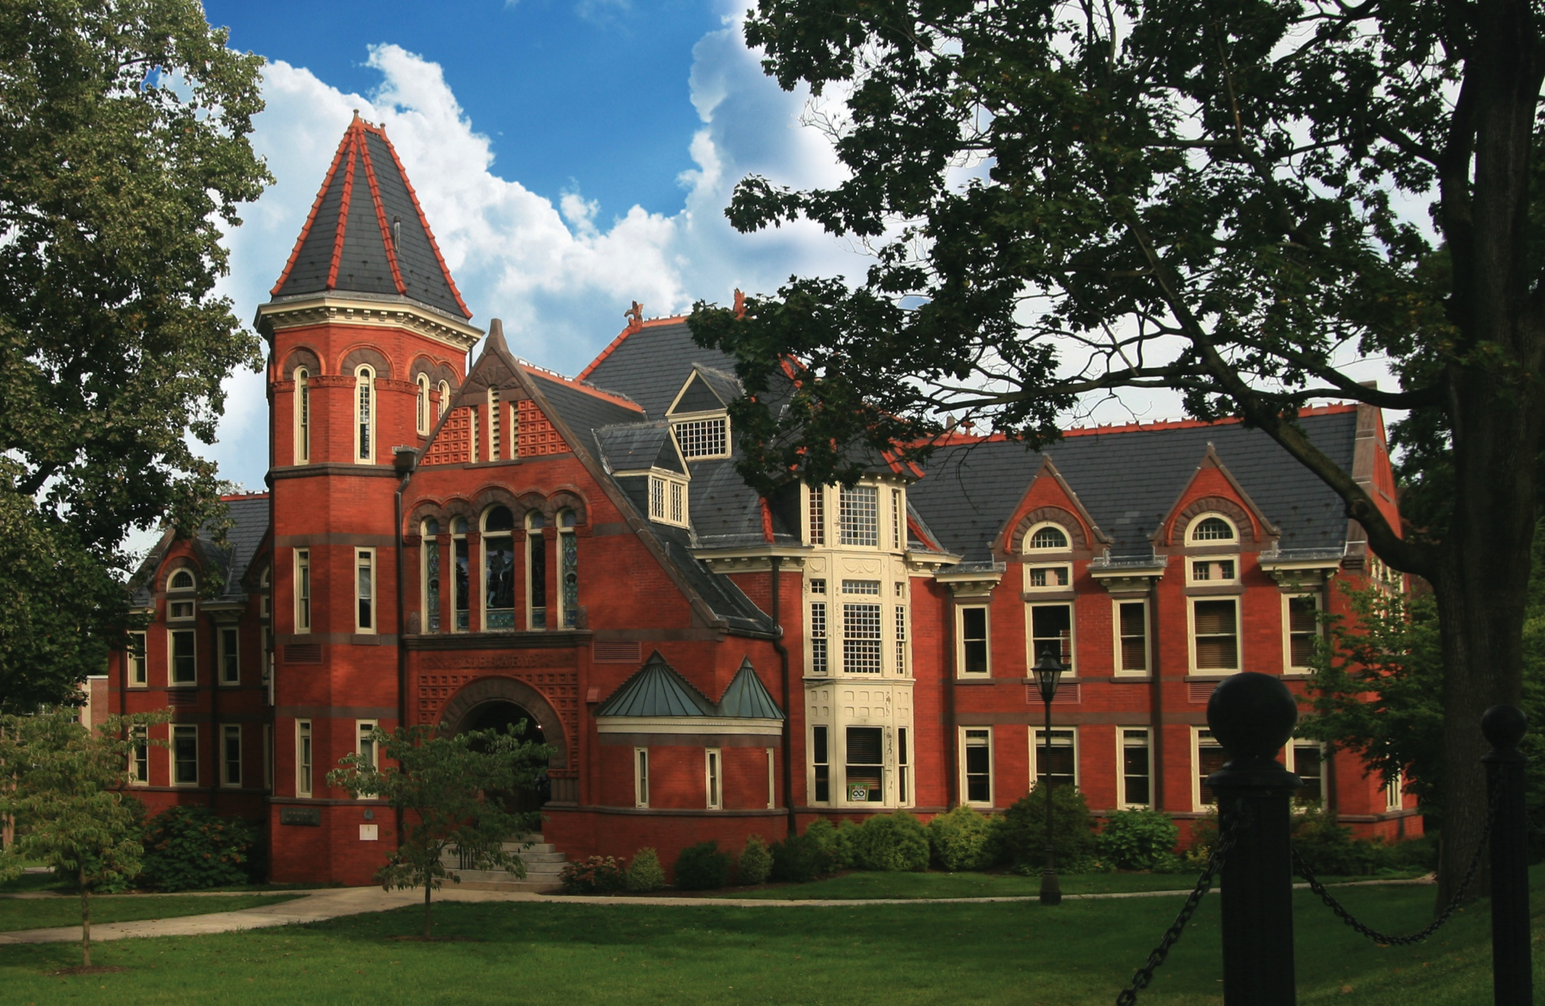
Presentation for AHSS Advisor Workshop
NUTS AND BOLTS OF DEGREE AUDITS
October 5, 2021
Registrar’s Office

Slide 2
WELCOME AND INTRODUCTION
Megan Jones
Assistant Registrar for Degree Audit and Curriculum

Slide 3
DEGREE AUDITS

Slide 4
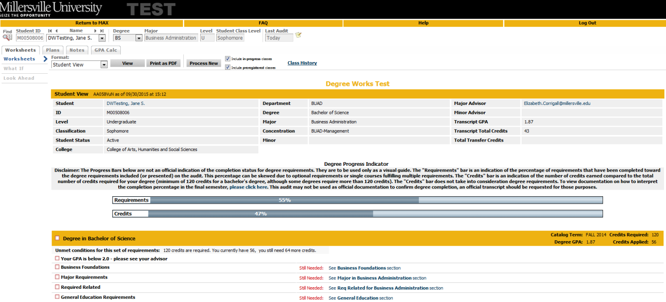
Student View Worksheet
Registrar’s Office

Slide 5
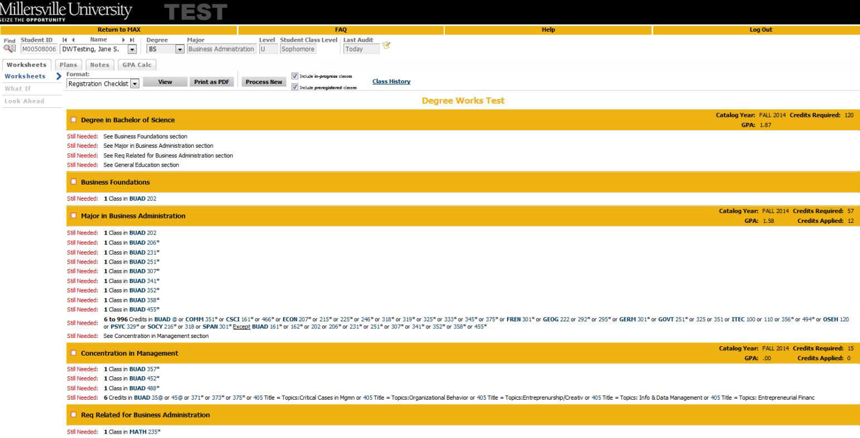
Registration Checklist Worksheet
Registrar’s Office

Slide 6
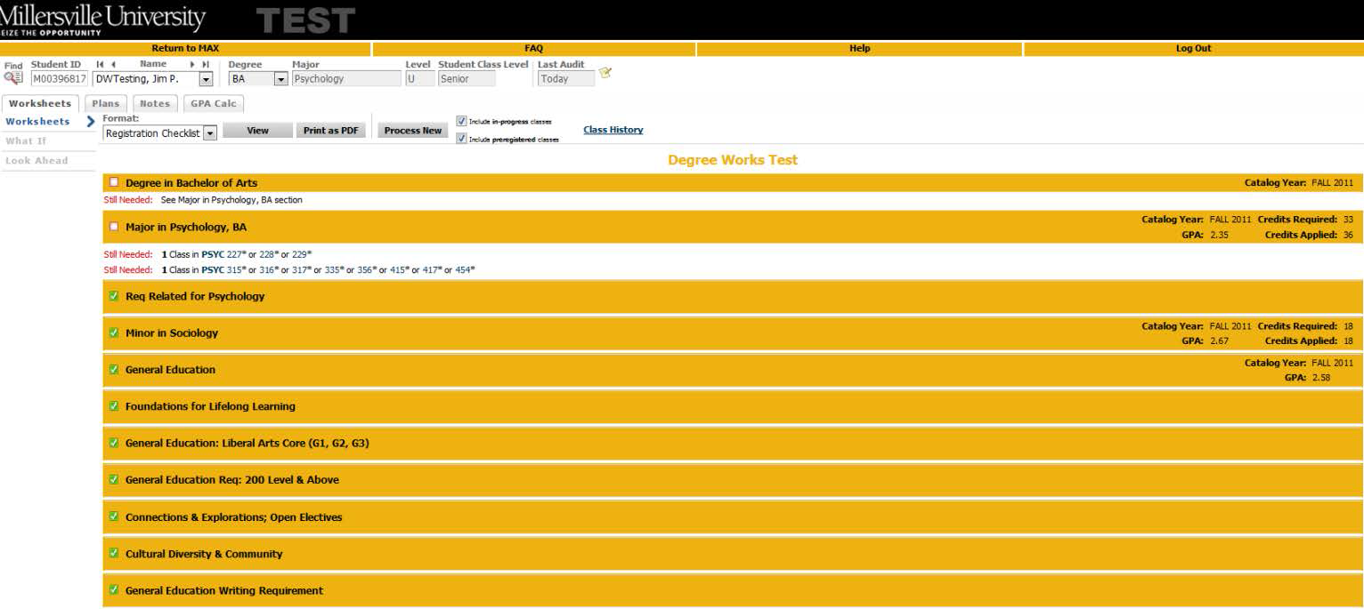
Registration Checklist Worksheet
Registrar’s Office

Slide 7
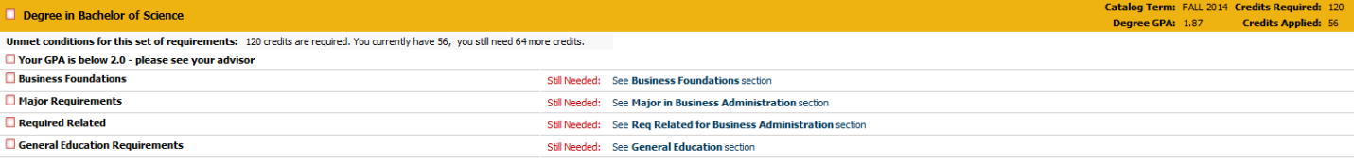
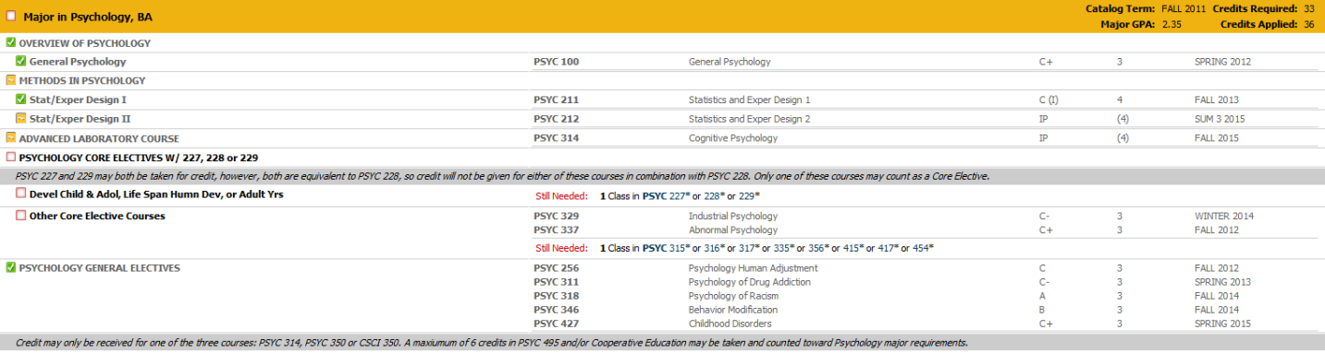
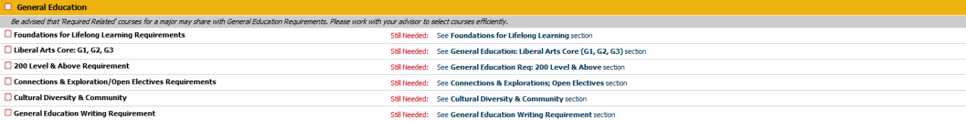
Requirement Blocks
Degree, Major, Required Related, General Education, etc.
Registrar’s Office

Slide 8


Easy to Read Progress Indicators
Complete, Not Complete, In-progress, Nearly Complete
Registrar’s Office

Slide 9
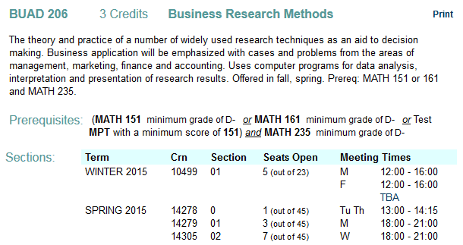
Course Link
Link directly to Banner catalog and schedule listing
Registrar’s Office

Slide 10
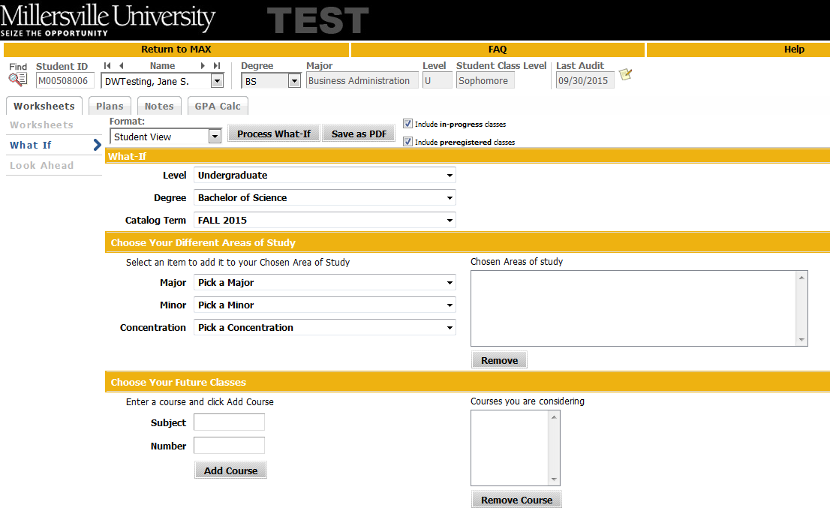
What-If Audits
Allows a student or advisor to run a scenario of changing major, adding minor, adding or removing option, etc against their current course work.
Registrar’s Office

Slide 11
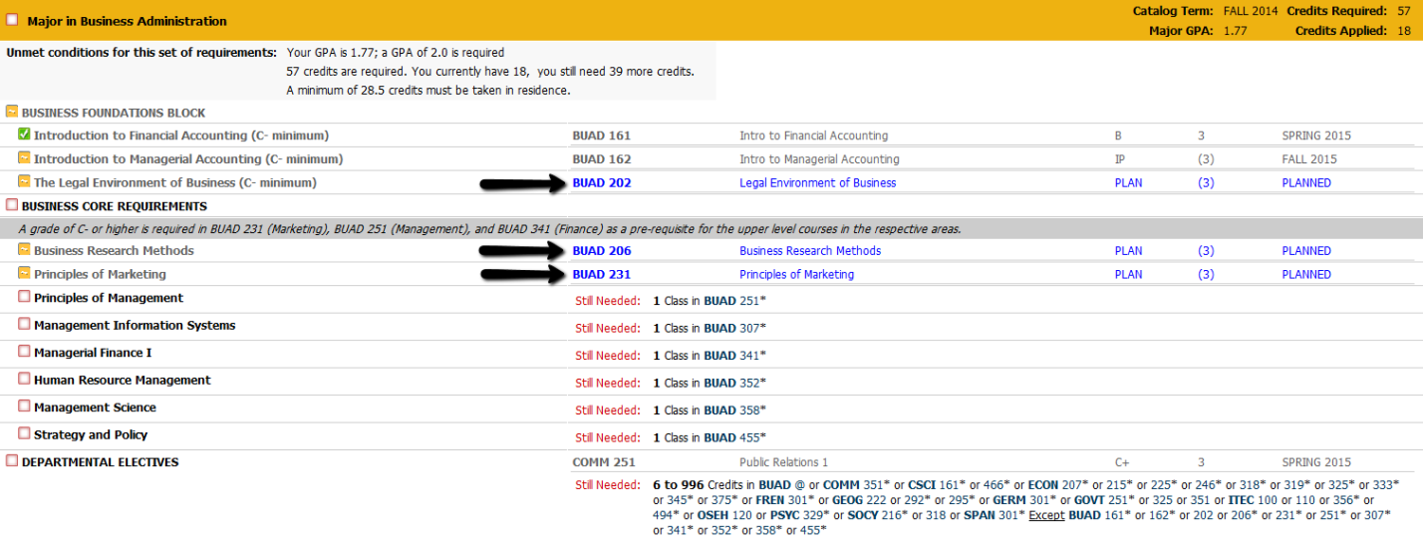
Look Ahead
Allows students or advisors to manually type in planned courses to see how they will fall on the degree audit to the requirements.
Registrar’s Office

Slide 12
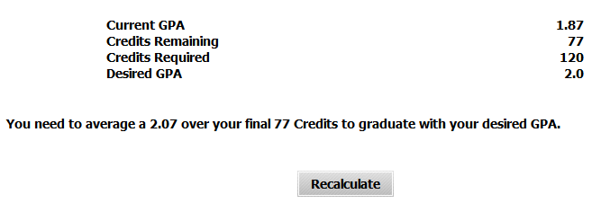
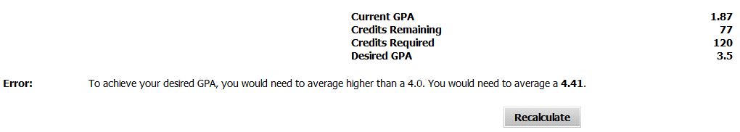
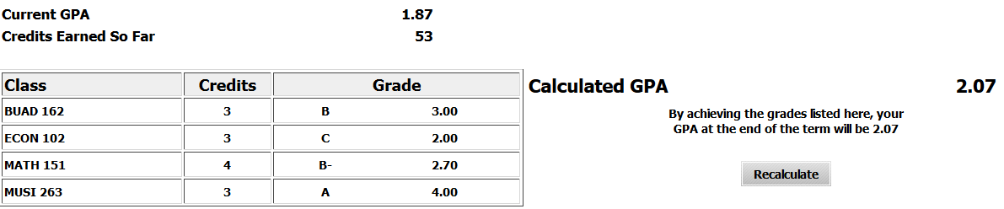
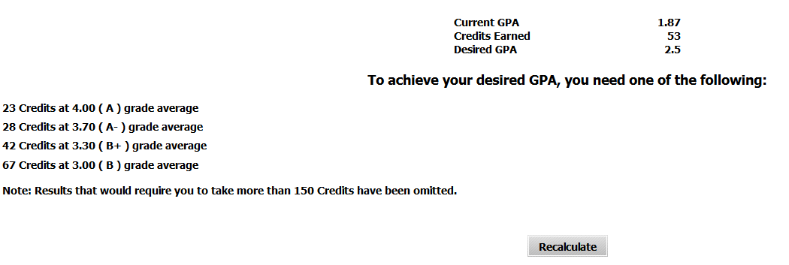
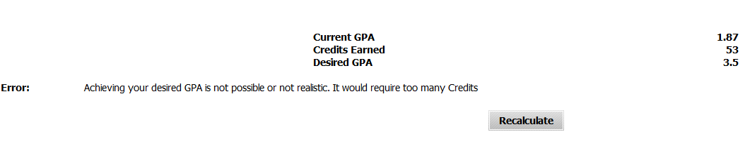
GPA Calculators
Realistic goal-setting, mapping of personal aspirations, path for achieving honors or avoiding probation. USE WITH CAUTION. REPEATS ARE NOT CONSIDERED.
Graduation Calculator
Term Calculator
Advice Calculator
Registrar’s Office

Slide 13
COMMON QUESTIONS

Slide 14
Why is this (G1, G2, G3) course not being applied in Gen Ed?
Students cannot take courses from their major department in the Gen Ed Liberal Arts Core.
Students cannot take more than two (2) classes from the same department in Gen Ed Liberal Arts Core. i.e. not all courses may be from the same department
  COMM/THEA is one department
  SOCY/ANTH is one department
  FREN/GERM/SPAN/JAPN/HUMN is one department
  GEOG can be G2 or G3, no more than 2 GEOG courses may be used

Slide 15
What can “Share”?
1 Class between Major and Minor
Required related is not part of the major, those classes WILL share with Gen Ed requirements
Dual majors or dual degree may share as much as applies to the requirements of each. Whichever major is primary is how Gen Ed will be enforced (i.e. if primary major is ART, art classes may not be used in Gen Ed
Dual majors with less than 150 credits receive ONE degree, but both majors. If a student completes 150+ credits with their dual major, they can be awarded both degrees (BSE and BFA for example).

Slide 16
Why is a course falling to “Insufficient”?
Withdrawn
Failed
BEING REPEATED.
  The audit will put the original course to insufficient as soon as the repeat is registered for.
  An ( E ) after a course indicates excluded
  An ( I ) after a course indicates included
  If the course has a passing grade, but no I or E, it is presently registered for.

Slide 17
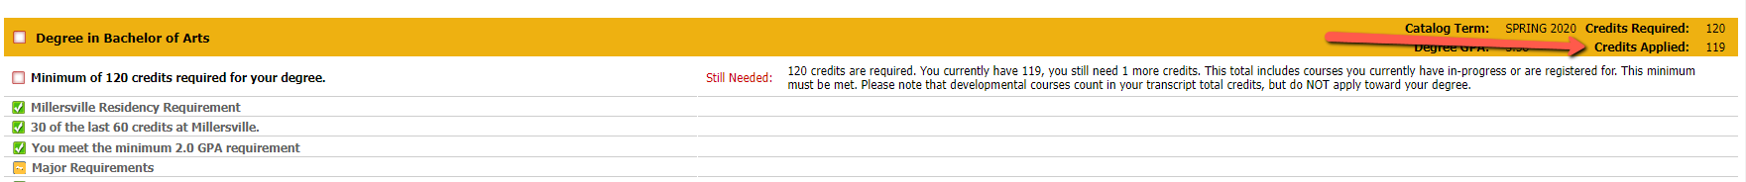
Do “Applied Credits” include in-progress and incomplete credits?
Yes!
Applied credits in the yellow degree bar include all courses that are in-progress or incomplete.
MATH 090 (and other classes with “0” as first number) are NOT included here, but ARE included on transcript credits. This is because they are credit-bearing classes, but considered developmental and do not count toward a bachelor’s degree.
APPLIED CREDITS MUST EQUAL 120.
  I have never encountered the audit being incorrect, be careful with students “calculating” their own credits.

Slide 18
G2 – The most mysterious Gen Ed Requirement
3 Classes and 9 credits are required in G2
Foundations for MATH is a separate requirement
2 Classes must be Natural Science (BIOL, CHEM, ESCI, PHYS, some GEOG)
1 Class must have a Lab component
When no courses have been taken:
Still Needed: 9 Credits and 3 Classes in @ @ with Attribute G2 additionally you need a minimum of 2 Classes from BIOL @, CHEM @, ESCI @ or PHYS @ additionally you need a minimum of 1 Class from @ @ with Attribute L
As a student completes the “additionally” statements those will go away

Slide 19
G2 – Continued
For example if a student has taken or registered for BIOL 100 which is a Natural Science and a Lab, the audit will state:
Still Needed: 6 Credits and 2 Classes in @ @ with Attribute G2 additionally you need a minimum of 1 Class from BIOL @ or CHEM @ or ESCI @ or PHYS @
The audit removes the lab and 1 of the natural sciences from the advice since it’s already been taken.
If the student has already fulfilled the Lab and the Natural Science qualifiers, it will state:
Still Needed: 3 Credits and 1 Class in @ @ with Attribute G2
The remaining course can be another G2 MATH or CSCI or any other G2
As long as it is not from the same department

Slide 20
G2 gets 3 Slides!
Sometimes the audit does not pick the best courses. If you have a student that has a course they say was a lab, but their lab is unmet, occasionally the audit will choose a non-lab over a lab if all courses taken are from the same department. Please email degreeaudit@millersville.edu

Slide 21
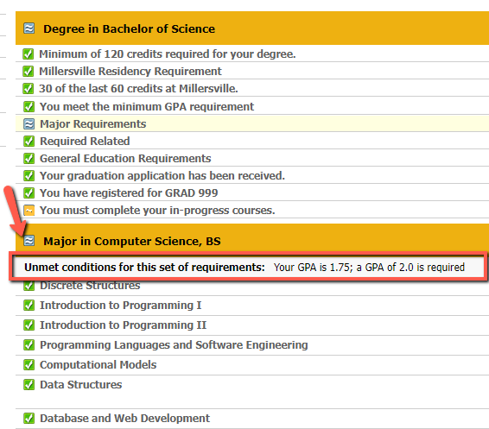
The student appears to have completed all requirement blocks, why isn’t the audit complete?
Check for HEADER Qualifiers
The blue double tilde means that a header qualifier hasn’t been met
Header Qualifiers are in the light gray bar under the yellow bar that starts a requirement block (like major).
Examples
  Minimum 2.0 GPA for Majors and Minors
  Residency Requirement (50% of major or minor must be from MU)
  Minimum level (2 classes at 300/400 level in minor)

Slide 22
No Exception!
It’s important to note that Millersville does not have ability to make exception to PASSHE requirements:
  Major and Minor and Overall GPA of 2.0
  Residency Requirement (50% of major and minor credits from PASSHE institution)
  30 of the last 60 credits must be from Millersville
  120 credits for a bachelor’s degree

Slide 23
Course Program of Study
To be eligible to receive financial aid, courses must fall to the Course Program of Study.
  Avoid the “other electives” category
  Be sure students are completing exception requests in a timely manner and/or Academic Program Changes if appropriate.

Slide 24
ONLINE FORMS!!
Exception to Graduation Requirements
Academic Program Change Request (formerly Major or Minor Form)
Graduation Application
Withdraw from a Course
All are in MAX and linked on the Student Forms Center.

Slide 25
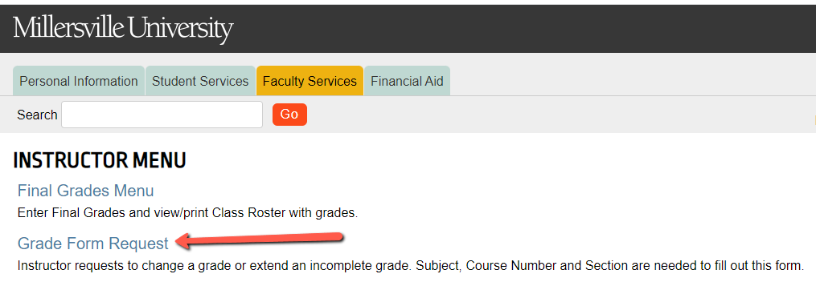
ONLINE FORMS!!
Grade Change and Incomplete Extension (NEW!) in MAX

Slide 26

QUESTIONS?
degreeaudit@millersville.edu

Slide 27
STUDENT PLANNER
Check back in Spring 2022
for the “Planning is Everything” presentation to learn more about this feature!

