Slide 1
Interfolio Review, Promotion & Tenure
Millersville University Candidate Workshop

Slide 2
Agenda
Interfolio overview
Terms
Dossier
Materials
Collections
Guidelines
Completing the packet
How to find support

Slide 3
Important Terms
Review, Promotion & Tenure: An Interfolio module used to facilitate the review process anytime a candidate submits materials for committee review.
Templates: Standardized, repeatable processes for all review types.
Cases: The lifecycle of a candidate as they progress through a standardized review cycle.
Packet: The collection of materials by which a candidate is being reviewed.
Dossier: A tool for all faculty to store and manage job, fellowship, and promotion or review documents in one place.
Committee: Groups of users that can review the candidates’ case at a given step of the review process.

Slide 4
www.interfolio.com
Notes:
Updated

Slide 5
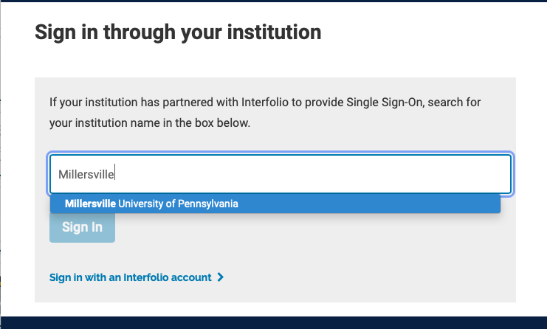
Search for Millersville
Notes:
Updated

Slide 6
PRODUCT DEMO

Slide 7
How to find support:
Interfolio Knowledge Base
product-help.interfolio.com
User Guides
FAQs and Best Practice Documentation
Contact Interfolio’s Scholar Services Team
help@interfolio.com or
(877) 997-8807

