Slide 1
Interfolio Review, Promotion & Tenure
Millersville University Committee Training

Slide 2
Agenda
Interfolio Key Concepts
Candidate Experience
  Review Interfolio Dossier
  Submit a Packet for Review
Committee Member/Manager Experience
  Review Case Materials
  Upload Committee Files
  Committee Communications
  Move Case Forward or Backward
How to find support

Slide 3
Important Terms
Review, Promotion & Tenure: An Interfolio module used to facilitate the review process anytime a candidate submits materials for committee review.
Templates: Standardized, repeatable processes for all review types.
Cases: The lifecycle of a candidate as they progress through a standardized review cycle.
Packet: The collection of materials by which a candidate is being reviewed.
Dossier: A tool for all faculty to store and manage job, fellowship, and promotion or review documents in one place.
Committee: Groups of users that can review the candidates’ case at a given step of the review process.

Slide 4




User Roles
Types of users in Interfolio Review, Promotion & Tenure
Administrators
Create forms, templates and cases
Review packet and move cases forward/backward
Communicate with committee and candidate
Committee Managers
Review packet and move cases forward/backward
Communicate with committee and candidate
Committee Members
Review a candidate’s packet,
Download documents and leave comments
Candidates
Complete a packet with their materials to submit for review.

Slide 5

www.interfolio.com
Notes:
Updated

Slide 6
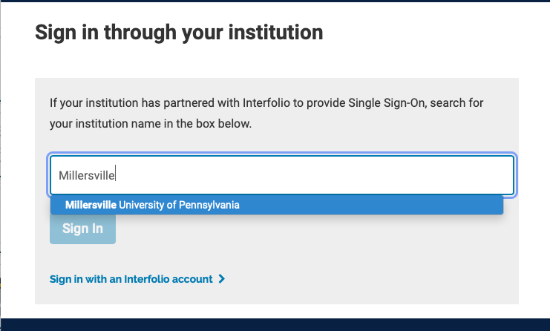
Search for Millersville
Notes:
Updated

Slide 7
How to find support:
Interfolio Knowledge Base
product-help.interfolio.com
User Guides
FAQs and Best Practice Documentation
Contact Interfolio’s Scholar Services Team
help@interfolio.com or
(877) 997-8807

