Slide 1



Grants Report 12-2021
View in Power BI
Last data refresh:
1/6/2022 3:12:30 PM UTC
Downloaded at:
1/6/2022 3:15:07 PM UTC

Slide 2
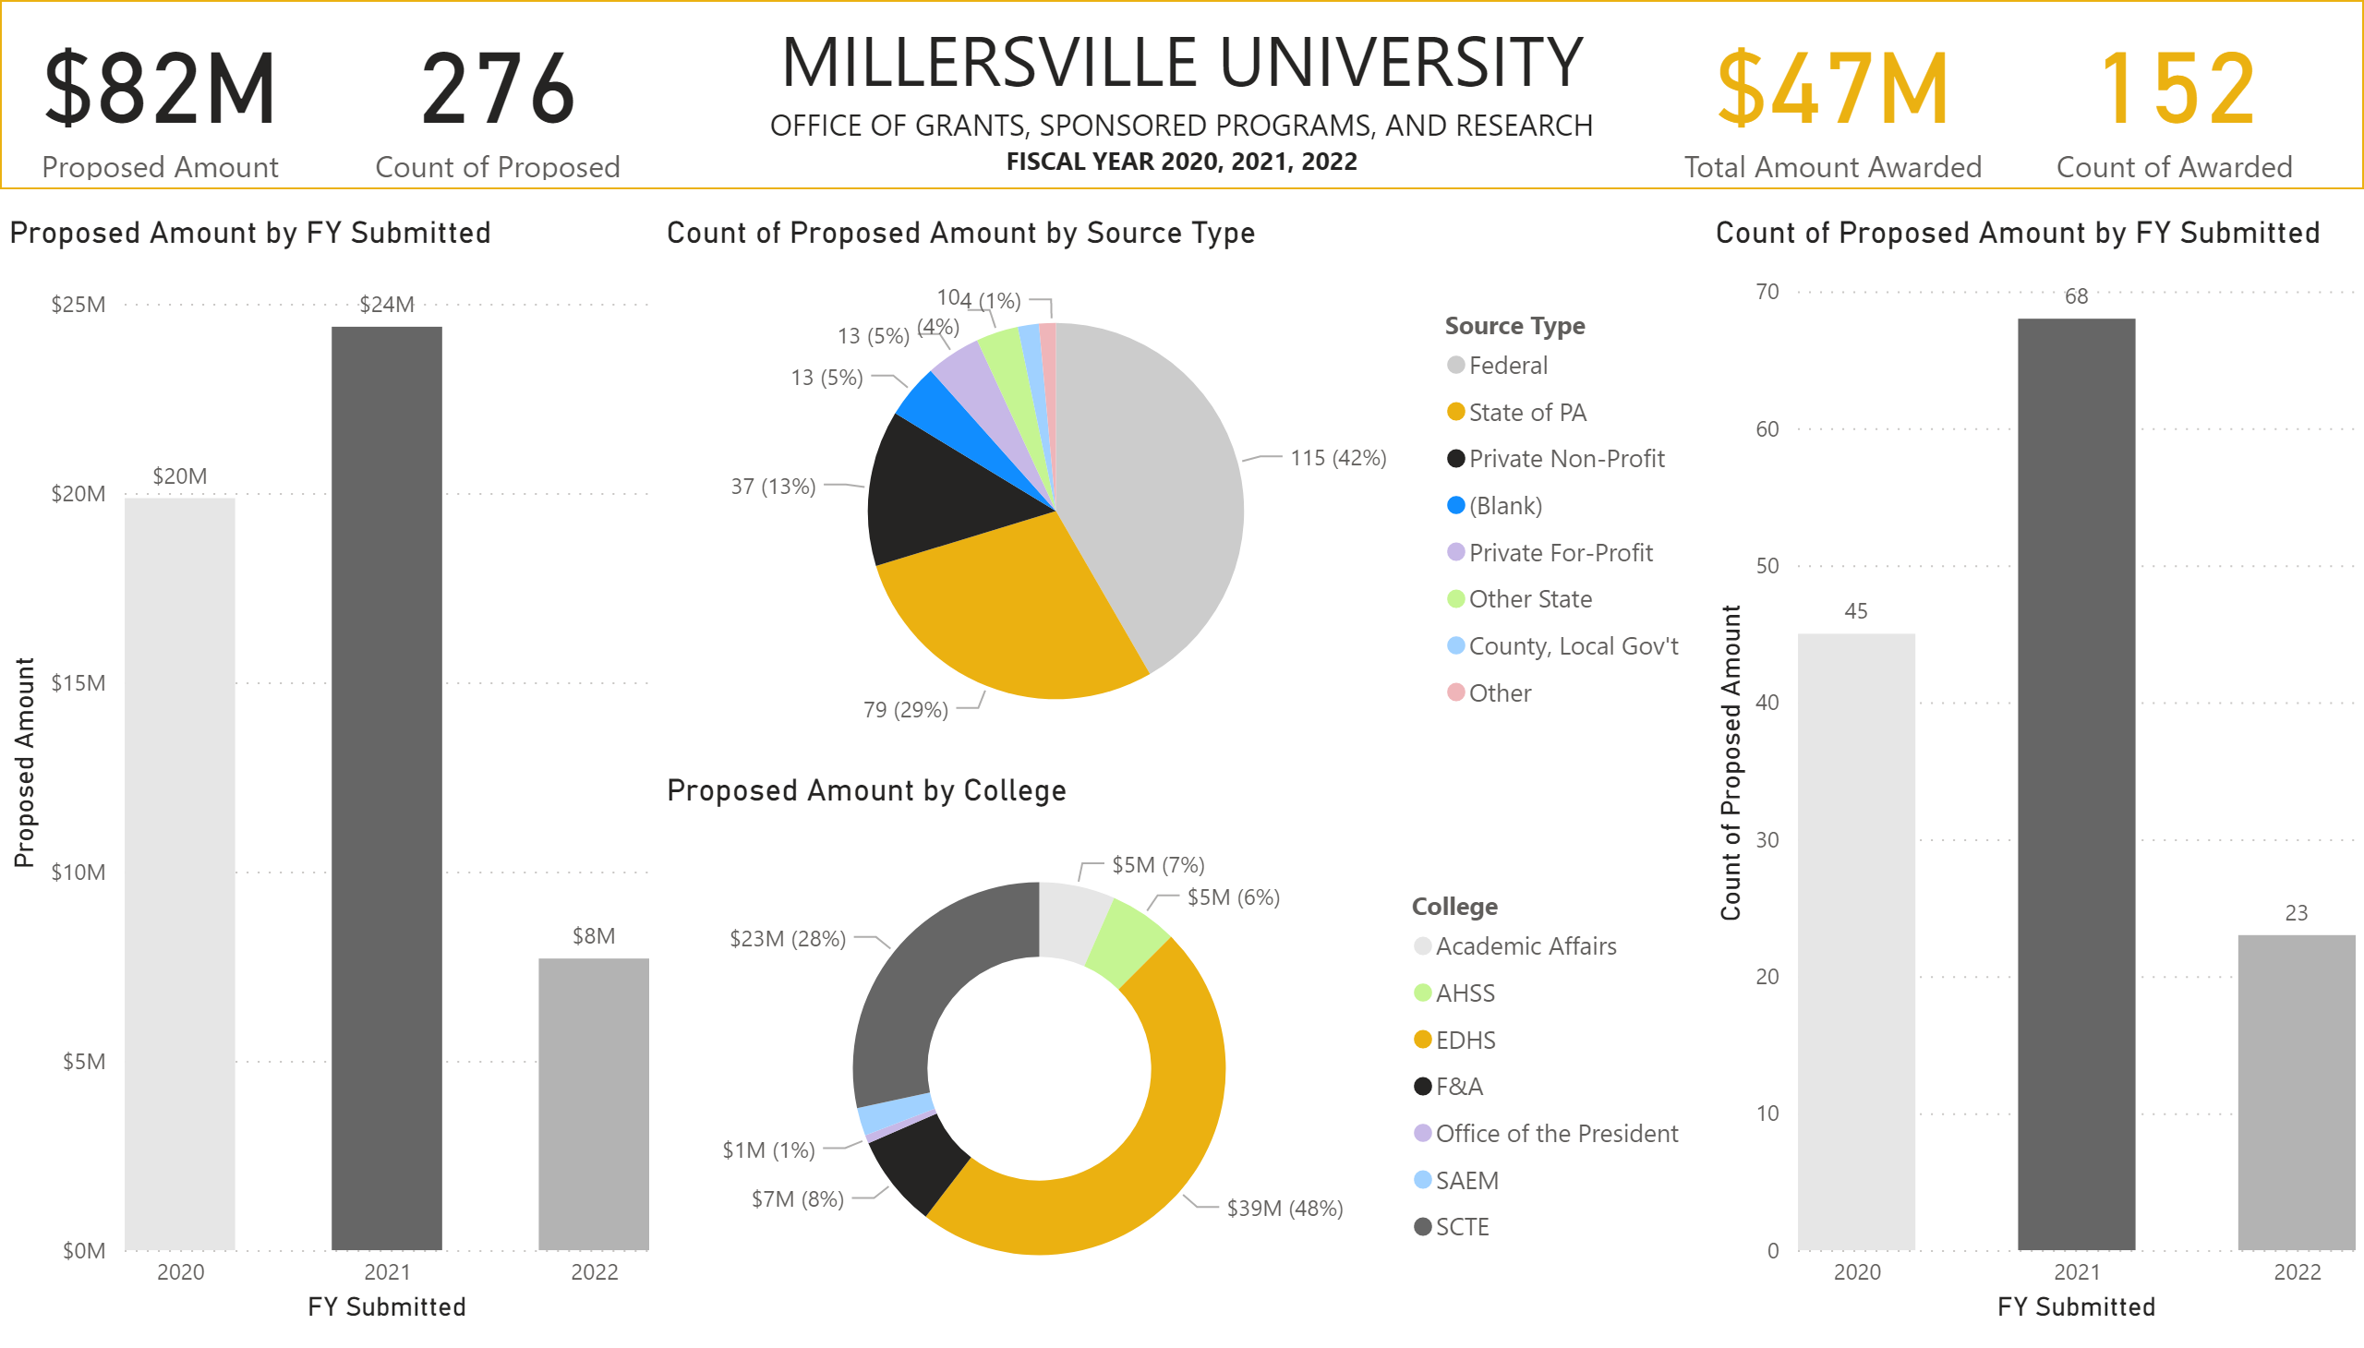
University Proposals
Notes:
shape
No alt text provided
textbox
No alt text provided
card
No alt text provided
card
No alt text provided
card
No alt text provided
card
No alt text provided
clusteredColumnChart
No alt text provided
clusteredColumnChart
No alt text provided
pieChart
No alt text provided
donutChart
No alt text provided

Slide 3
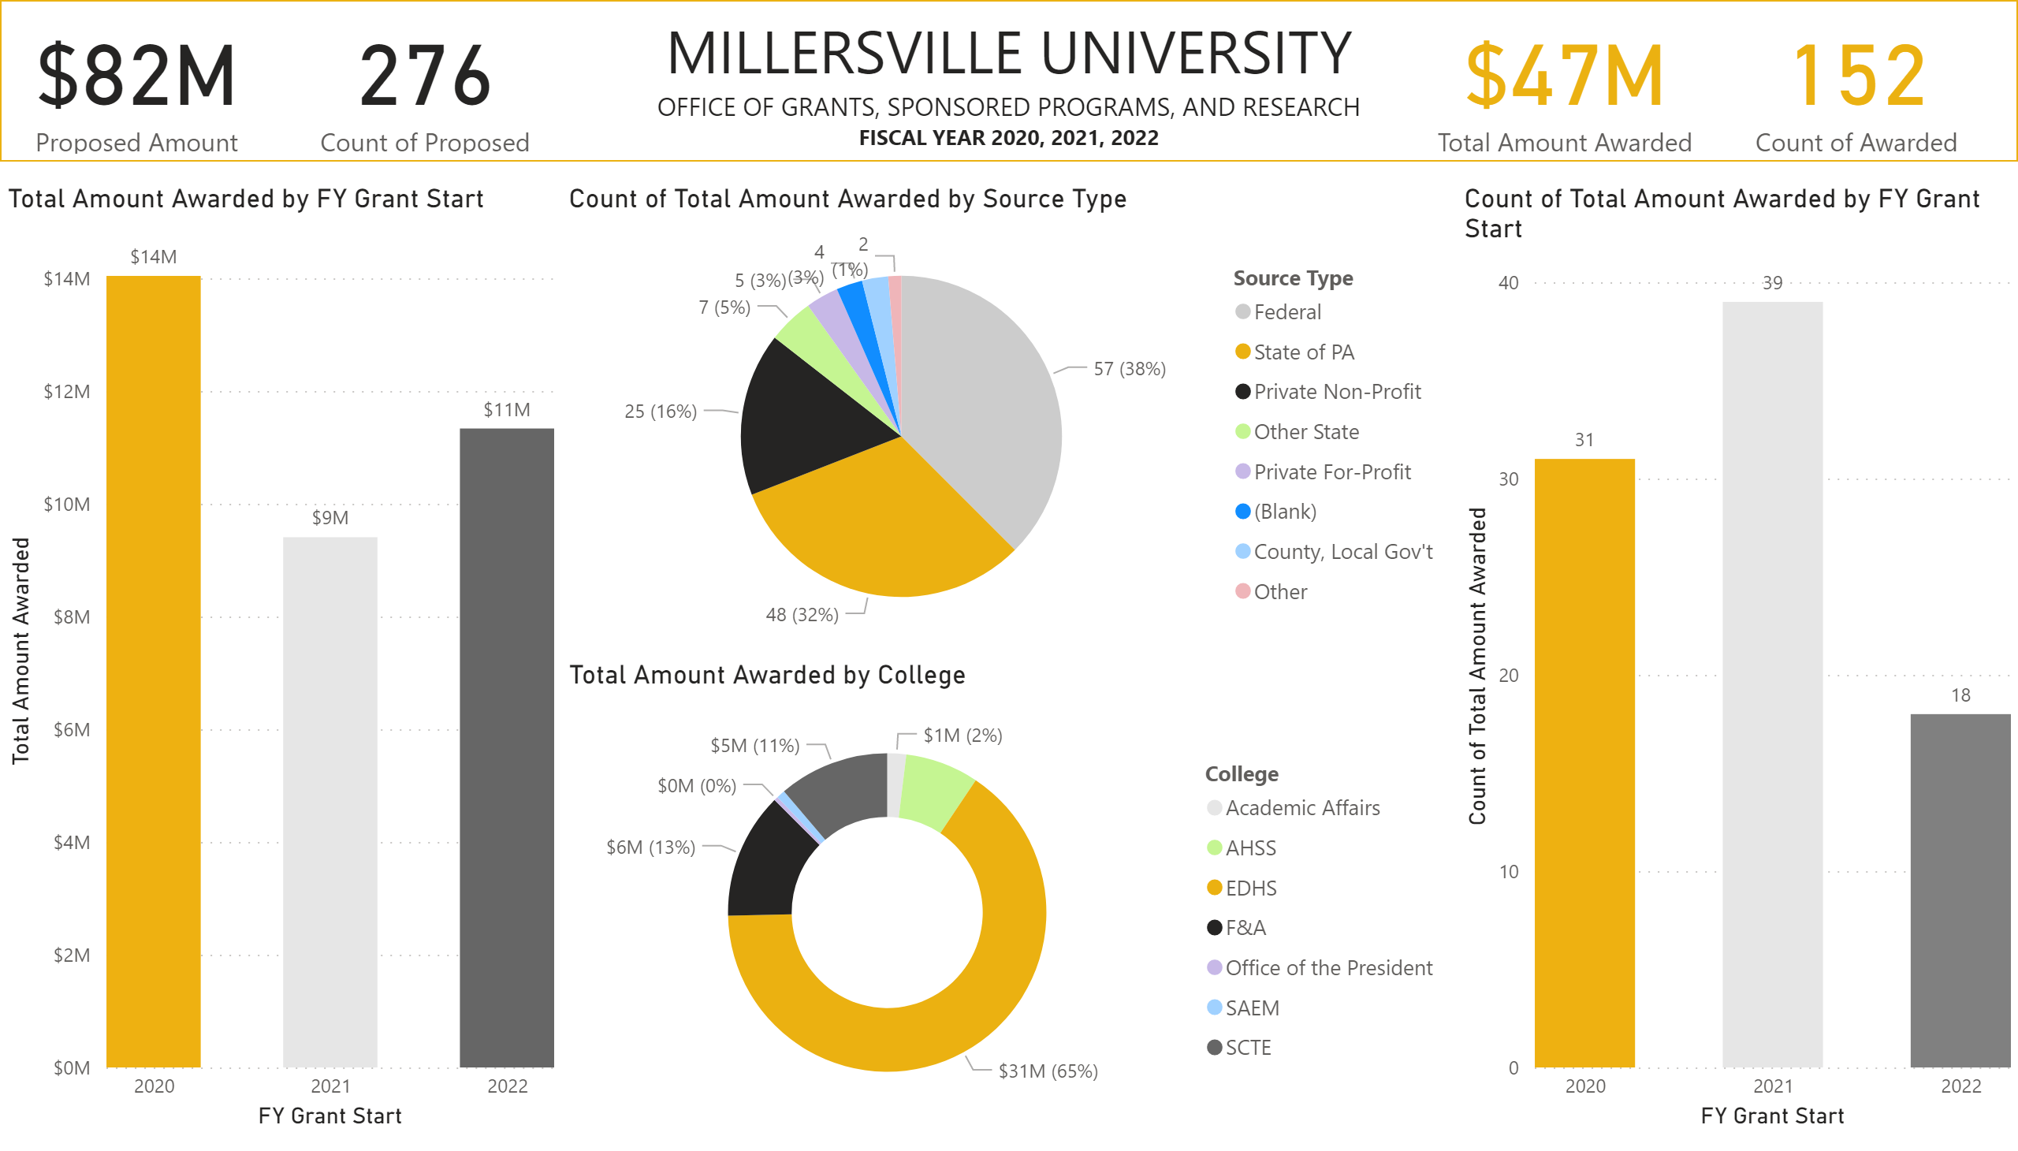
University Awarded
Notes:
shape
No alt text provided
textbox
No alt text provided
card
No alt text provided
card
No alt text provided
card
No alt text provided
card
No alt text provided
clusteredColumnChart
No alt text provided
clusteredColumnChart
No alt text provided
pieChart
No alt text provided
donutChart
No alt text provided

Slide 4
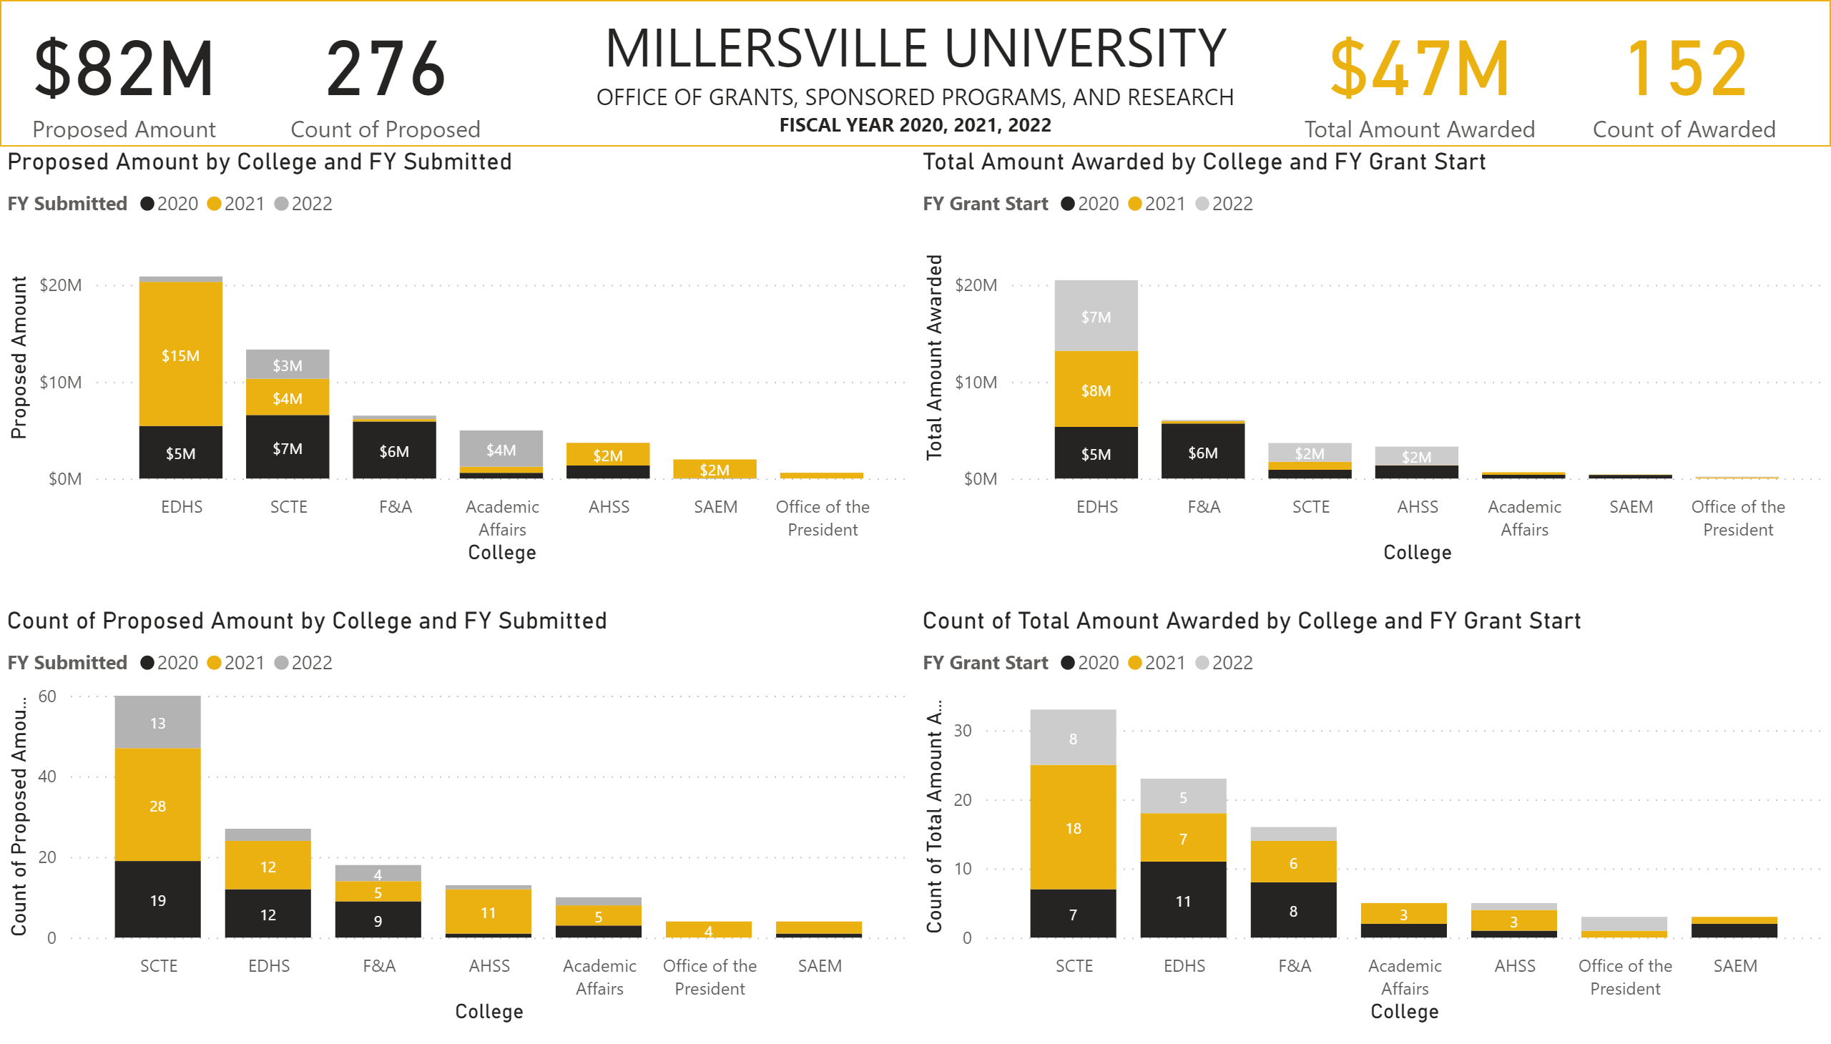
By College
Notes:
shape
No alt text provided
textbox
No alt text provided
card
No alt text provided
card
No alt text provided
card
No alt text provided
card
No alt text provided
columnChart
No alt text provided
columnChart
No alt text provided
columnChart
No alt text provided
columnChart
No alt text provided

Slide 5
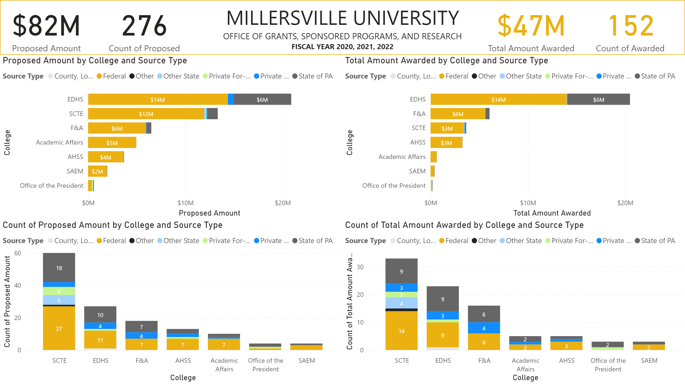
Source Types by College
Notes:
shape
No alt text provided
textbox
No alt text provided
card
No alt text provided
card
No alt text provided
card
No alt text provided
card
No alt text provided
barChart
No alt text provided
barChart
No alt text provided
columnChart
No alt text provided
columnChart
No alt text provided

