Slide 1



Student Grants Report
View in Power BI
Last data refresh:
12/14/2021 1:23:33 PM UTC
Downloaded at:
12/15/2021 2:05:55 PM UTC

Slide 2
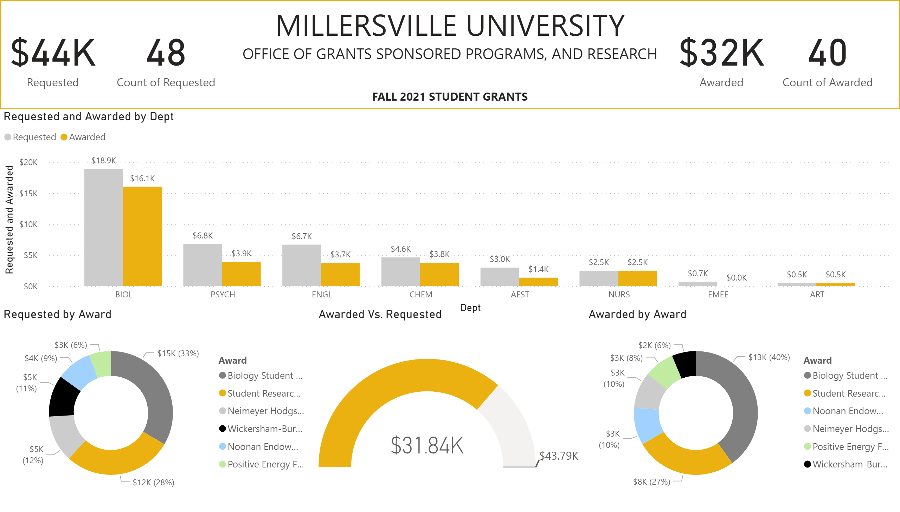
Amounts
Notes:
Awarded Vs. Requested
No alt text provided
donutChart
No alt text provided
donutChart
No alt text provided
clusteredColumnChart
No alt text provided
card
No alt text provided
card
No alt text provided
card
No alt text provided
card
No alt text provided
textbox
No alt text provided
shape
No alt text provided

Slide 3
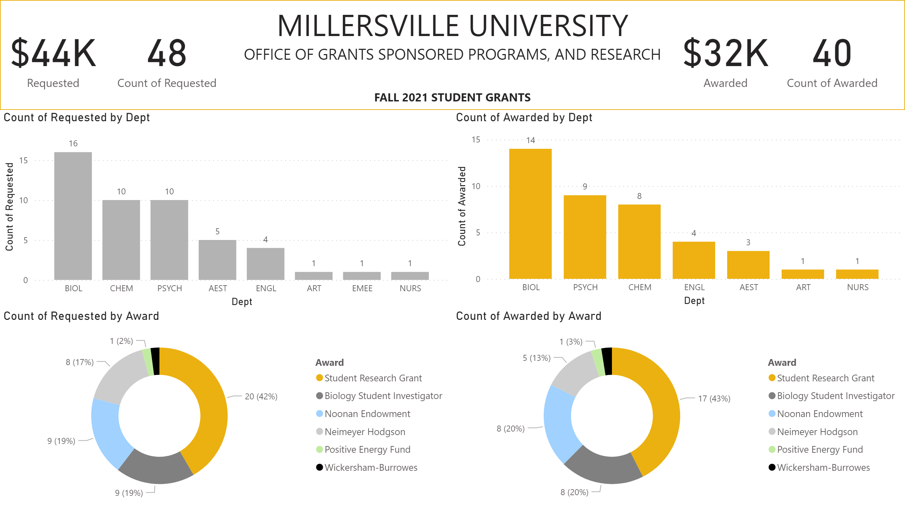
Counts
Notes:
clusteredColumnChart
No alt text provided
donutChart
No alt text provided
donutChart
No alt text provided
clusteredColumnChart
No alt text provided
card
No alt text provided
card
No alt text provided
card
No alt text provided
card
No alt text provided
textbox
No alt text provided
shape
No alt text provided

Slide 4
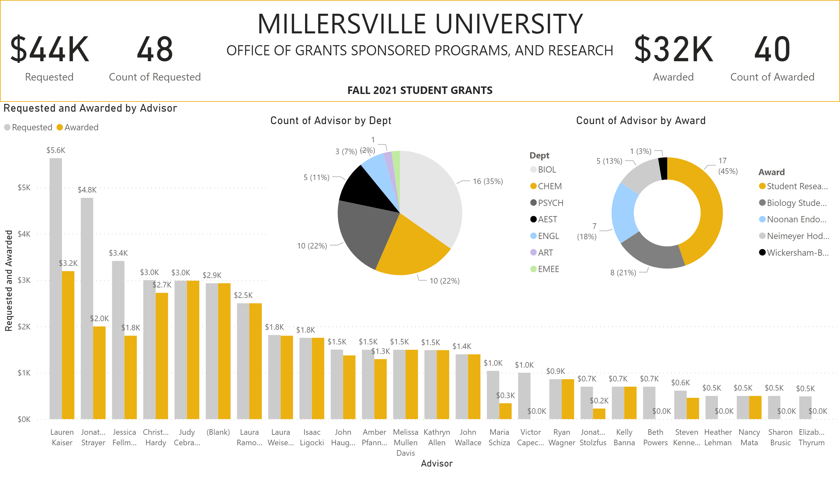
Advisors
Notes:
shape
No alt text provided
textbox
No alt text provided
card
No alt text provided
card
No alt text provided
card
No alt text provided
card
No alt text provided
clusteredColumnChart
No alt text provided
donutChart
No alt text provided
pieChart
No alt text provided

