Slide 1
Expense Reports for
Blanket Requests

Slide 2
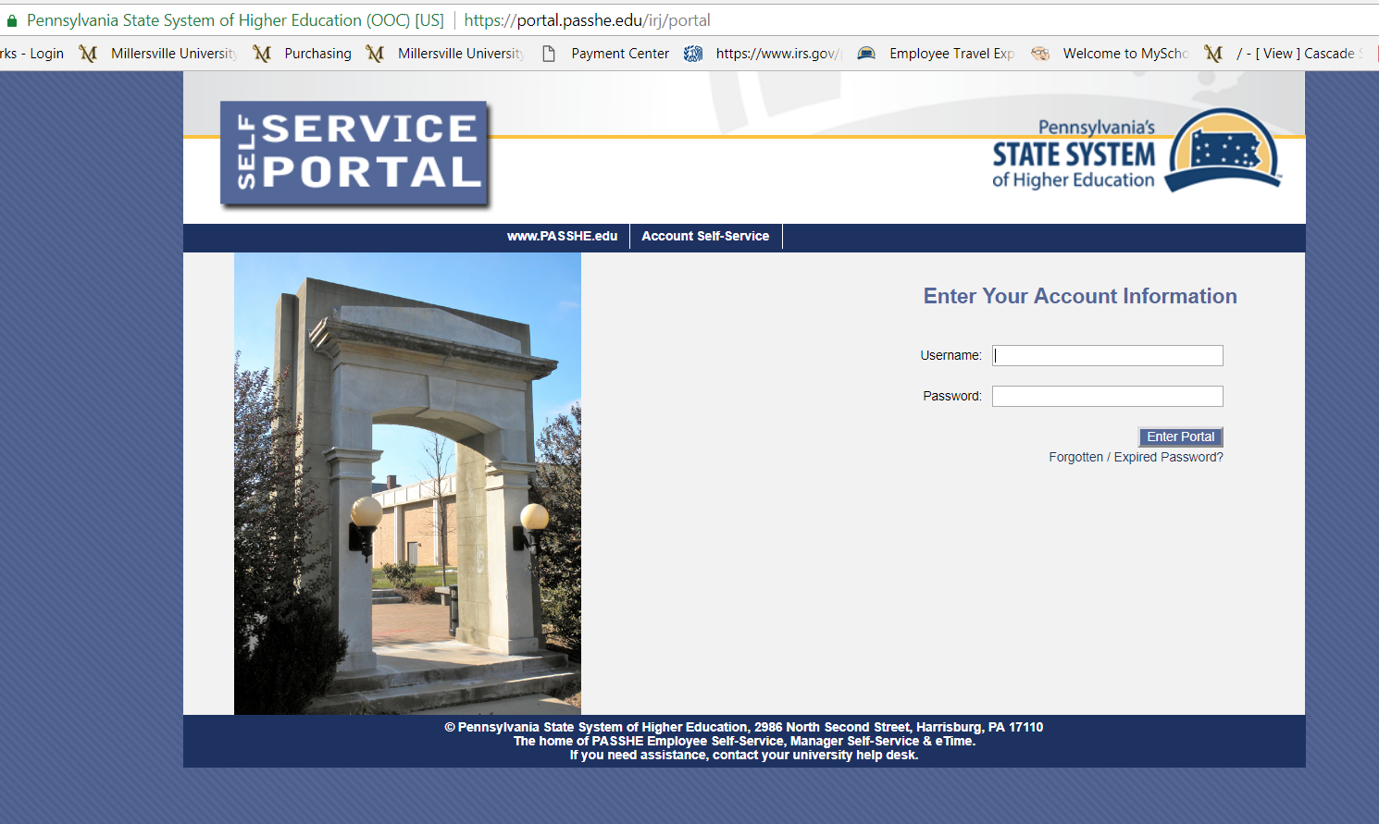
Travel Management is an online travel reimbursement system accessed through the ESS (Employee Self Service) Portal.
Log into ESS

Slide 3
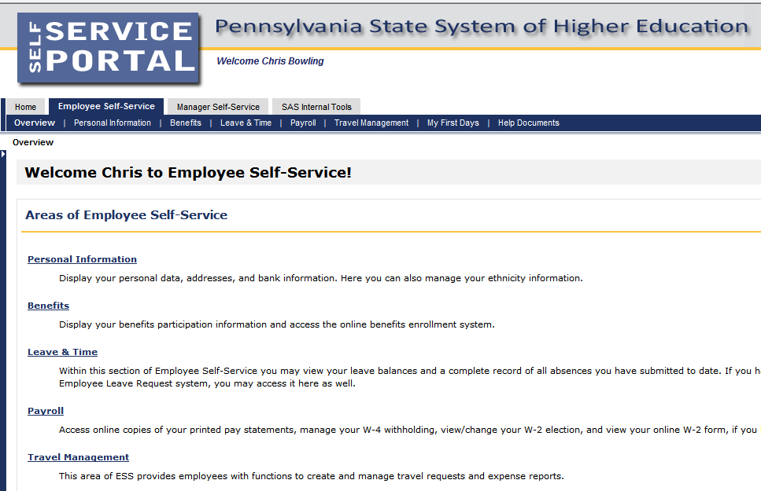
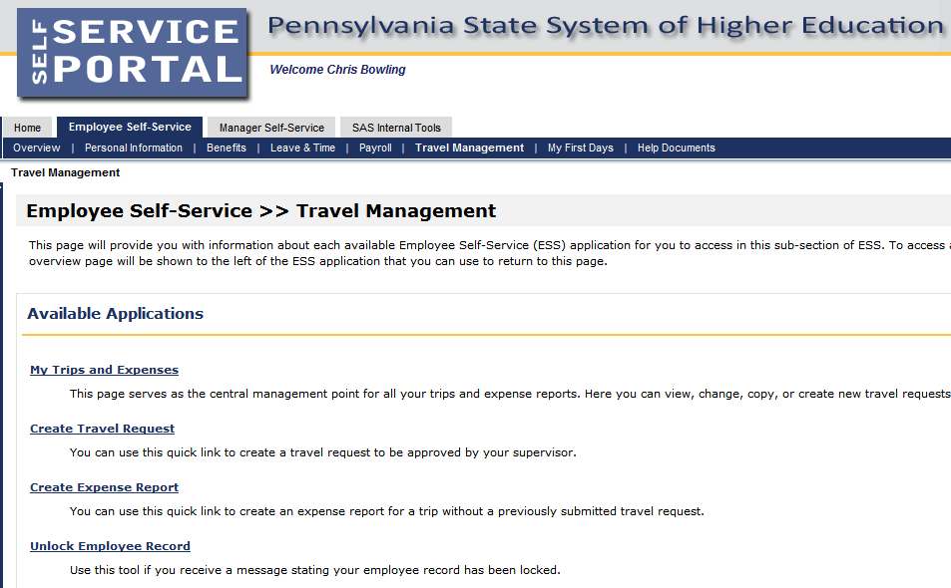
ESS Portal / Travel Management

Slide 4
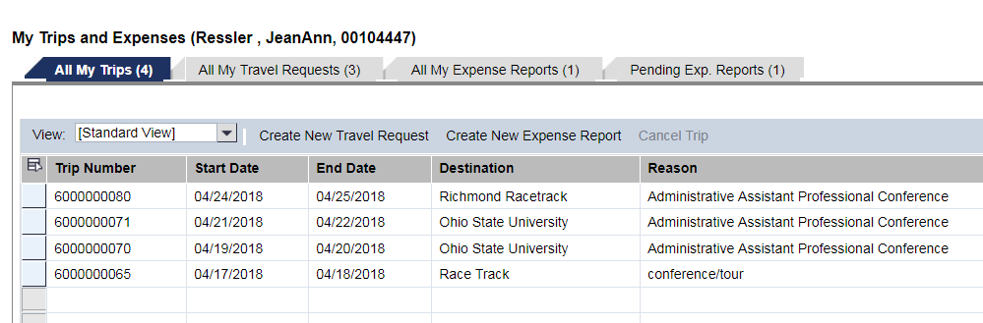
Getting Started
Create New Expense Report
Dashboard
The only time you would start with an expense report is if you have a paper blanket travel request. You will include this TR# in the comments.
If you click on “Create New Expense Report” and nothing happens, check your pop-up blockers

Slide 5
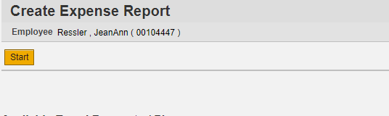
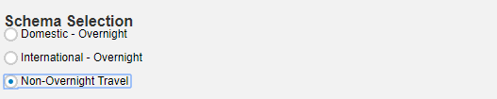
Choose Trip “Schema”
Choose the trip schema that matches your travel. Click “Start”.

Slide 6
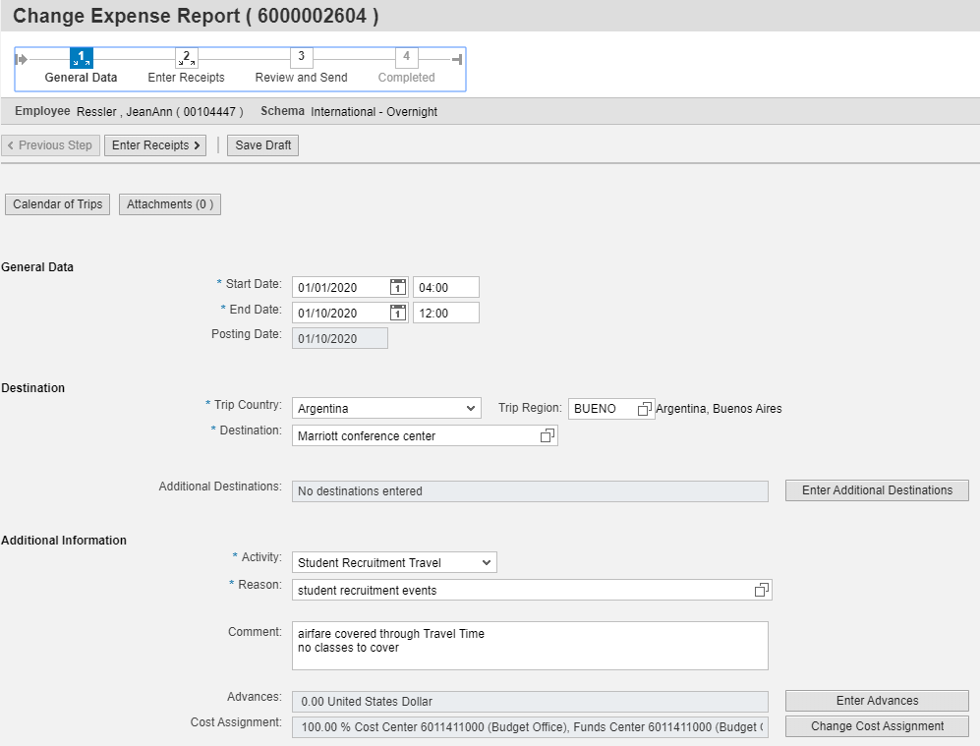
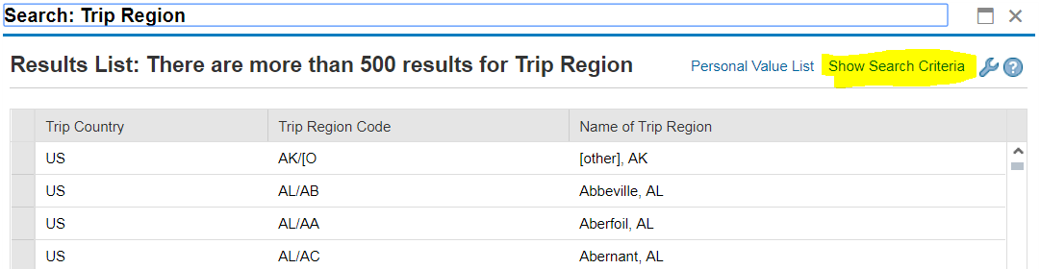
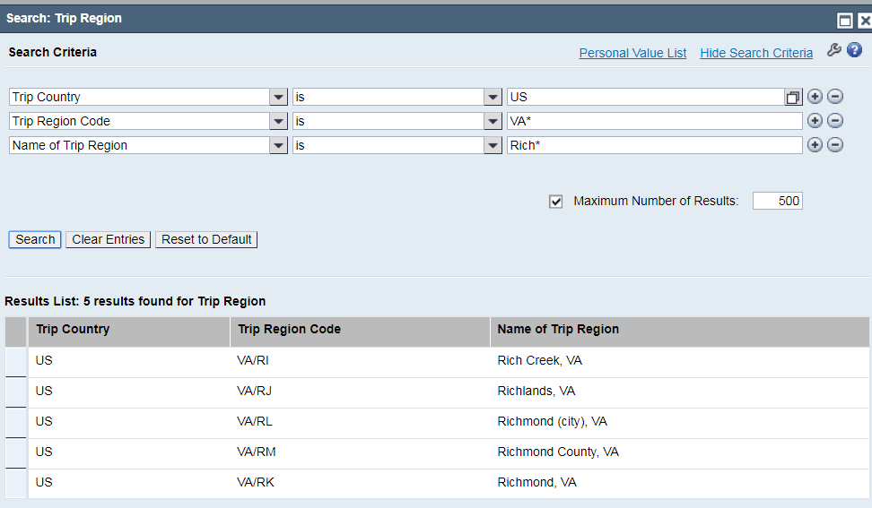
Step 1 - Enter General Data
Receipts are to be taped to a sheet of paper in date order and uploaded as few documents as possible.
Travelers can attach documents here once * items are completed and saved as a draft
See Trip Region file
Dates and times must be entered in military time
Destination is free text to indicate a location where you will be doing business. Example: “ABC Convention Center”, or “Marriott Center City”
Additional destinations can be added once * items are completed and saved as a draft
**You must Enter paper TR# in comments here
The asterisk is the search wild card and MUST be used

Slide 7
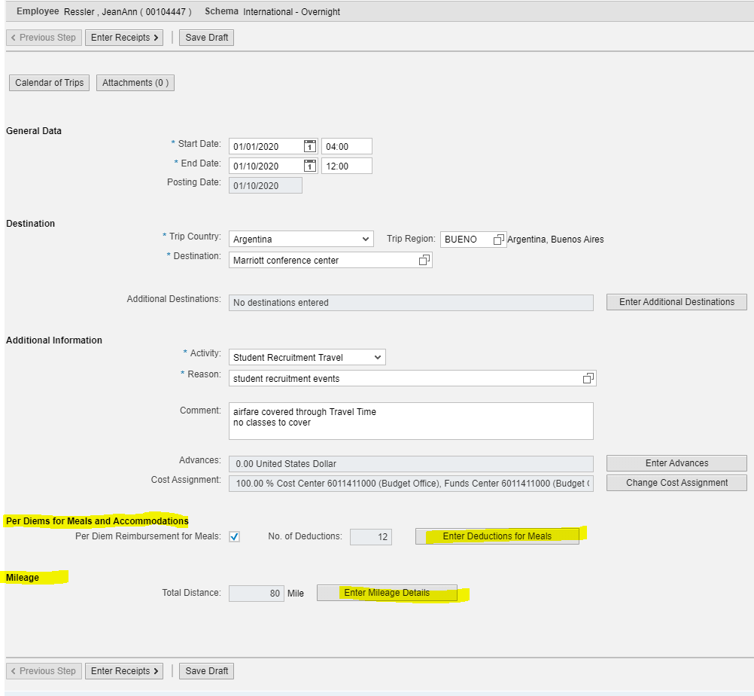
Step 1 - Enter General Data (cont.)
Activity would likely be “General Travel” or “Training/Development Travel”. These are the GL codes that most employee travel falls under. “Administrative Travel” is not typically used.
Reason is free text to enter the business purpose of the travel. Example: “XYZ conference”, or “Administrative Assistant Conference”; etc
Subsistence rates are based on the US General Services (USG) Rates. The USG rates are based on the county. Enter the city you will be doing business in. See notes below.
Comment:
This should be where anything is documented that should be known when audited.
Example: “Enterprise”, or “Enterprise rate taken but POV used”, or “conference hotel”, or “hotel split with 3 faculty members”, or “ Conf reg paid with PCard”, or justification for an expense, or any or all above, etc.
Advances are never used under any circumstance (all expenses are paid via Expense Report).
Cost Center changes would need to be made here if 100% or split in %, or on the receipt entry in the expense report if by $ amount or if not known up front. Any
You will need to either claim per diem by checking the box and entering deductions (meals provided by event), or enter receipts in the next step AND enter mileage here if claiming mileage (if you are claiming the Enterprise rate as it is less, per policy, you need to enter that under “other” on the next step “Enter Receipts”)
Next step, enter receipts.

Slide 8
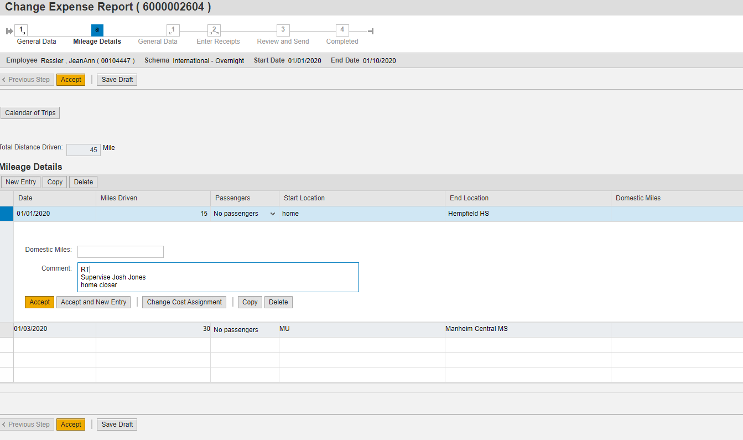
Enter Mileage
Create
Enter mileage: choose date, passengers, start location and end location. Enter any details in the comments. Accept and new entry for more dates or Accept when completed.
Accept when all lines are completed.

Slide 9
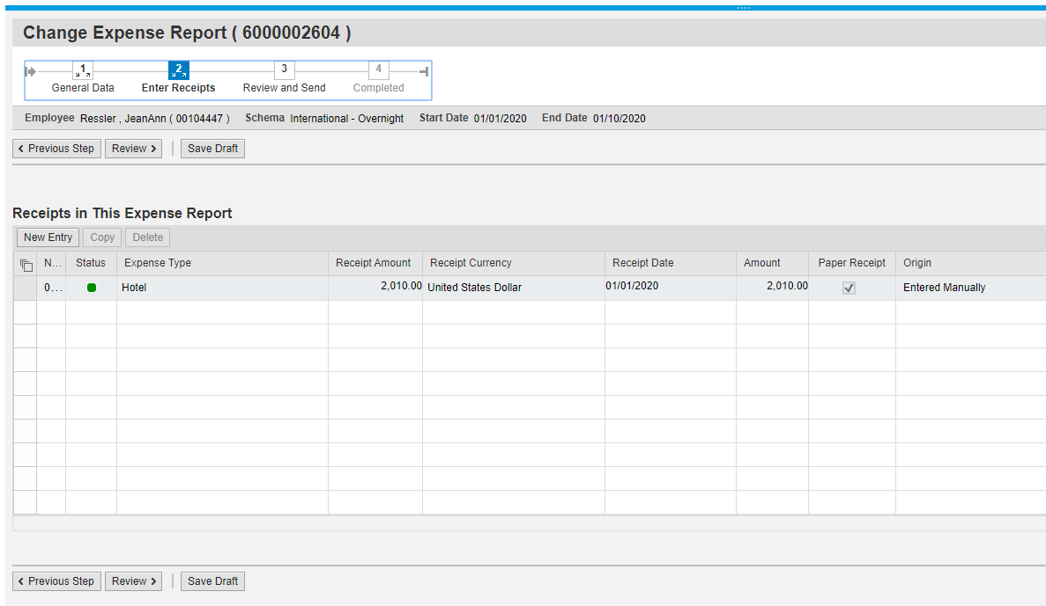
Enter Receipts
Enter any receipts for expenses if you have them.

Slide 10
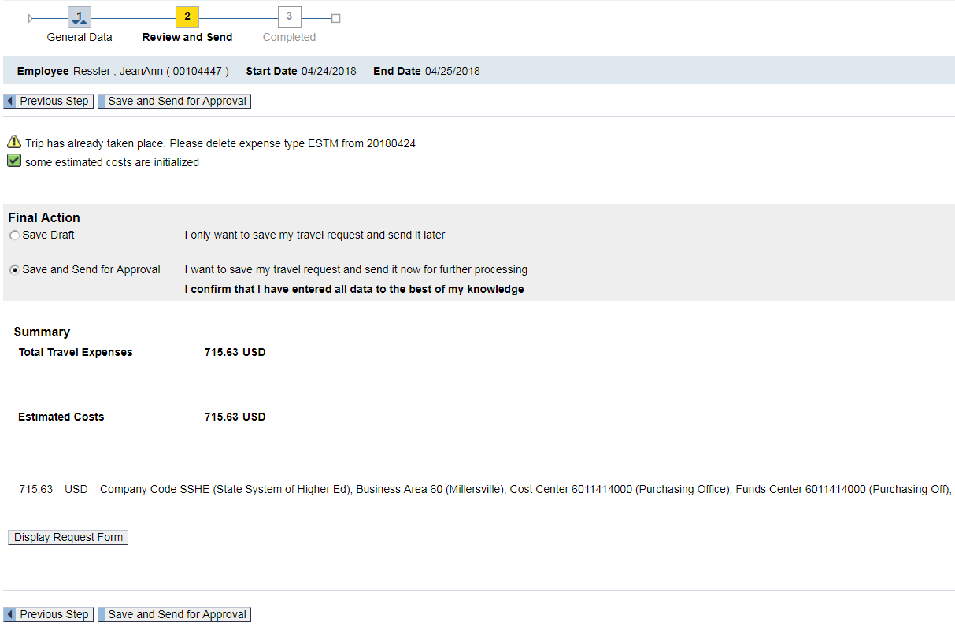
Step 2 – Review and Send
**NOTE:
Travel Assistants can enter the information and “Save Draft” only, Traveler MUST review and “Save and Send for Approval”

Slide 11
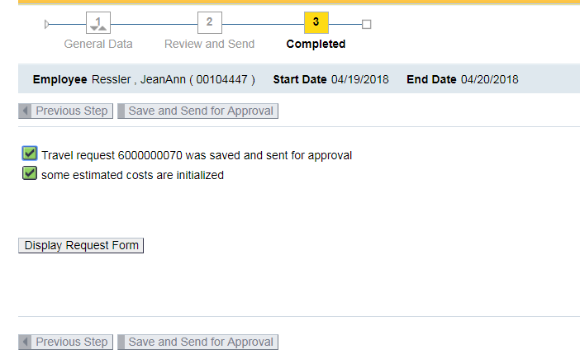
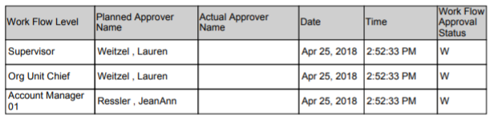
Step 3 - Completed
The Work flow approval log will show the status of the approval steps once the trip was saved and sent for approval. “Display Request Form” – at the end of the form will be the work flow
If a trip is missing a step, it will not route properly as there is an error in the set up. Please contact Purchasing to get that updated and the traveler will be notified to re-"save and send for approval".

Slide 12
Notes:
All reimbursements are made through the Expense Report. This is a change from the paper process.
ALL expense reports would be created from the approved Travel Request. The Travel Request must be approved before the blue “create” link is available under the “Expense Report” column of the Travel Request. DO NOT use “Create New Expense Report” as it will generate a whole new trip and will not release encumbrance from the budget.
Travel Assistants can complete the entry; however, they only have permissions to Save Draft.
The travel must enter the Travel Request or Travel Expense Report and go to Step 3, review, and Save and Send for Approval.
Any time you go into a trip through “change” you will need to re-”save and send for approval” so it goes back to routing.
You can check on the status of the Request or Report at any time by going in to “My Trips and Expenses”, “All My Trips” tab, click on the trip line in question, details will come up below the dashboard where you can “display/print”. Or you can “All my Travel Requests” or “All My Expense Reports” tab click on the “Display/Print” button on the dashboard. You can review expenses submitted and at the end of the document you can view the status on the “Approval Log”.
Grants and additional cost centers would need to be entered at the Travel Expense Report receipt level. It will route to those grant approvers of cost center/IO/WBS managers at that time.
Please, tape receipts to a sheet of paper in date order and upload receipts in as few file uploads as possible. This would assist the auditing process. There will be times this is not possible, that is ok.
Please make sure your receipt dates are correct.
It will take time to get used to it…we all understand that.
We are learning with you. If we are all patient, we will have much success. Thank you!!

